Slide 1
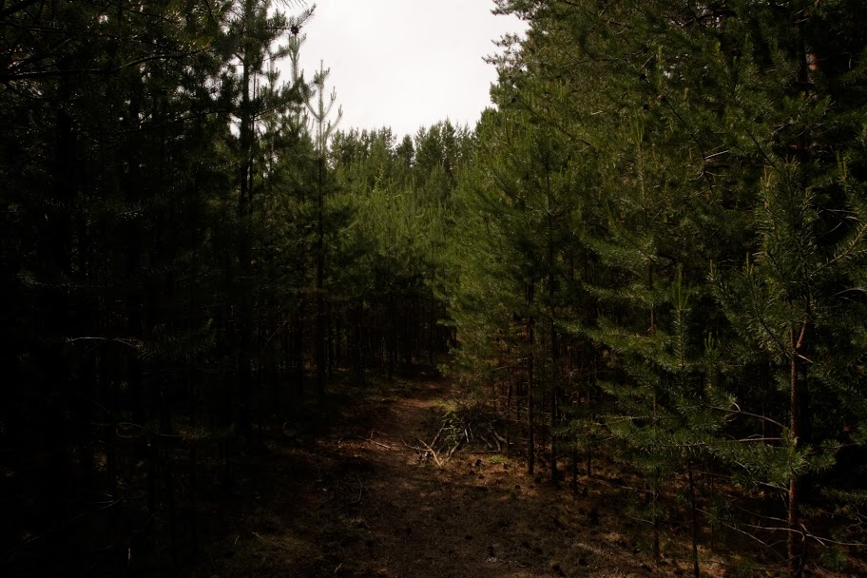
Kašəŋ in Kazym Khanty:
free choice indefinite
or universal quantificator
Daria Motora, Lomonosov MSU

Slide 2
The material was obtained in July 2019 during the expedition to Kazym village in the Beloyarsky district of the Khanty-Mansi region (Ugra), mainly by elicitation.
The research was supported by Russian grant No. 19-012-00627 "Semantics and syntax of Ural-Altaic languages in functional-typological and formal perspectives"
Data and resourses

Slide 3
Semantic map for indefinites [Haspelmath 1997]
List of semantic functions in which indefinite pronouns are used:
(1) specific known (6) indirect negation
(2) specific unknown (7) direct negation
(3) irrealis non specific (8) comparative
(4) question (9) free choice
(5) conditional

Slide 4
Some examples
(1a) χʉj juχt-əs ? (1b) χʉj-at juχt-əs. who come-PST[3SG] who.INDEF come-PST[3SG] ‘Who came?’ ‘Someone came’
who | hʉj
who.INDEF | hʉj-at
who.NEG | nɛm-hʉj-at
when | χɵn
when.INDEF | χɵn-tɨ
when.NEG | nɛm χɵn-ti

Slide 5
Semantic map for Kazym Khanty (2018)
2019: (4) comparative: kašəŋ
(9) free choice: kʉš+INDEF / kašəŋ

Slide 6
Kašəŋ in dictionary [Соловар 2014]
Kašəŋ means ‘every’ (universal quanificator):
Every man helps somehow.
This meaning remains actual now, but some speakers seem to use kašəŋ also as free choice indefinite.

Slide 7
Kašəŋ in free choice contexts: case 1 (referent)
(2) a. muλsər maw wʉj-a
which.INDEF candy take.IMP
‘Take some candy [one piece]’
b. kašəŋ maw wʉj-a
every candy take.IMP
%‘Take some candy [one piece]’,
%‘Take every candy [all]’

Slide 8
Kašəŋ in free choice contexts: case 2 (referent)
(3) {Which candy [of these on the table] I may take? – Well, any.}
a. kʉš kašən wʉj-a
EMPH every take.IMP
%‘Take any you want.’
%‘Take every you want [take all if you want].’
b. kăšen wʉj-a
every take.IMP
%‘Take any.’
%‘Take every’.

Slide 9
Kašəŋ in free choice contexts: case 3 (non-referent)
{We can solve any problem}
(4) kăšen wɛr wɛr-ti păk-λ-ew
every thing do-NFIN.PST can-NPST-1PL
%‘We can do anything.’
%‘We can do everything.’

Slide 10
Kašəŋ in free choice contexts: case 4 (non-referent)
{I can learn any song with these children, even a tough one}
(5) tăm ńawrɛm-en piλa kašən ar wɵnəλtə-ti păk-λ-əm
DEM child-POSS.2SG together every song learn-NFIN.NPST can-NPST-1SG
%‘I can learn any song with these children.’
%‘I can learn every existing song with these children.’

Slide 11
Kašəŋ in comparative contexts
Generally speakers seem to face difficulties interpreting russian comparative sentences.
Possible reasons:
unusual context (no need to compare non-referent items in real life)
inappropriate context (I suggested bad examples)
they do not use indefinites in comparative contexts, but something else
Possible strategies:
transform comparative to superlative
omit indefinite
use kašəŋ

Slide 12
Kašəŋ in comparative contexts: case 1
(6) Petja-en χɵχəl-λ muλsər ńawrɛm-ət ewəλt sora-šək
Peter-POSS.2SG run-NPST[3SG] which-INDEF child-PL among fast-COMP
‘Peter runs faster than some children [and slower than other].’
*‘Peter runs faster than any child.’

Slide 13
Kašəŋ in comparative contexts: case 1
(7) Petja-en kašən nawrɛm kińśa sora χɵχəl-λ
Peter-POSS.2SG every child than fast run-NPST[3SG]
‘Peter runs faster than any child.’

Slide 14
To be discussed
Can we talk about the development from the original UQ kašəŋ a free choice indefinite series?
Is it possible to define such common components of semantics between free choice pronouns and UQ, as [Bhat 2000] distinguishes between indefinite and interrogative pronouns (for them - lack of information)?
Maybe there are some better contexts that I could ask?

Slide 15
List of abbreviations
1 – 1 person, 2 – 2 person, 3 – 3 person, COMP – comparative, DEM – demonstrative pronoun, EMPH – emphatic particle, IMP – imperative, INDEF – indefinite, NFIN.NPST – infinitive, NPST – non-past tense, PL – plural, POSS – possessive, SG – singular

Slide 16
References
Соловарь 2014 — V. N. Solovar. Khanty-Russian dictionary (Kazym dialect). Khanty-Mansiysk: Ob-Ugric Institute of applied research and development, 2014.
Bhat 2000 – Bhat D. N. S. 2000. The indefinite-interrogative puzzle. Linguistic Typology 4:365-400
Haspelmath 1997 – Haspelmath M. 1997. Indefinite Pronouns. Oxford: Clarendon Press

