Slide 1
“Locative nouns” and emergence of a noun declination in Mande family
Valentin Vydrin
INALCO – LLACAN (CNRS) – IUF
St. Petersburg State University

Slide 2
Case systems in the Niger-Congo macrofamily
very rare (and certainly not reconstructable for any proto-level);
especially rare for the nouns (more available for the pronouns).
An exeption: a couple of Western Bantu languages, where cases are expressed by tones [Blanchon 1988; König 2005].

Slide 3
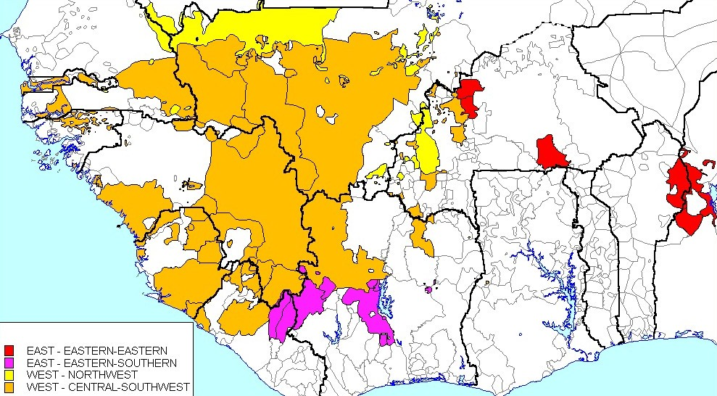
Mande family

Slide 4
Some charcteristics:
more than 70 languages (Ethnologue 2012)
genetic depth: more than 5000 years
2 big branches (Western and South-Eastern) subdivided into 11 groups
usually regarded as lacking morphology (no noun classes; TAM meanings are expressed mainly by auxiliary words…).

Slide 5
Rigid word order in Mande
Syntactic functions of NPs are expressed by words order and, for the obliques, by postpositions.
The word order (prototypical for the entire family):
Subj - Aux - DO – V – Obl PP

Slide 6
Example: Bambara
(1) Mìsi-` ye jí-` mìn.
cow-ART PFV.TR water-ART drink
‘A/The cow drunk water’.
(2) Ń ye mìsi-` gɛ́n.
1SG PFV.TR cow-ART chase
‘I chased the/a cow’.
(3) Ń ye jí-` dí mìsi-` mà.
1SG PFV.TR water-ART give cow-ART ADR
‘I gave water to a/the cow’.

Slide 7
A deviation:
Obliques without postpositions
Bambara: toponyms (with the exceptions for Màli: À táara Màli` lá ‘He went to Mali’);
a few nouns with locative semantics: só ‘house, home’, dá ‘mouth’, tɛ́gɛ ‘palm of hand’:
(4) Ń tɛ táa ń fà-` ká só.
1SG IPFV.NEG go 1SG father-ART POSS home
‘I won’t go to my father’s home’.
Also in some other languages of the family (Beng, Gban).

Slide 8
Looma (Southwestern group): “locative nouns” without declination
carry a definite article -ʋɛ̀ (cf. nouns of the “neutral class” with the article -y);
appear in the syntactic function of the oblique without postposition;
their form remains unchanged whatever their sytactic function may be.
(5) Kótí ɣà zíá-ʋɛ̀.
REF\stone.DEF PRES.COP REF\river-LOC.DEF
‘The stone is in the river’ [Mishchenko, ms.].

Slide 9
Southern and Southwestern Mande: noun + postposition fusion
Mwan: a couple of “locative nouns” which appear only in the oblique function (historically, fused with locative postpositions) [Perekhvalskaia, ms.].
wīìŋ ‘on the head’ < wḭ̄ ~ wīŋ ‘hair’.
(7) Bɔ̀tɔ̀ bébé ò ŋ́ wīìŋ.
bag many be 1SG.NSBJ head.LOC
‘I have many bags on my head’.
Other “locative nouns” gbɛ̄pāālōŋ ‛on the shoulders’ , zà̰tā ‛on the back’, (< zà̰ ‘space behind’), kwéláà ‛with a load’ (kwé ‛a load’); toponyms.

Slide 10
Kpelle (Southwestern group)
9 nouns have two forms, “basic” and “locative”. The latter results from fusion with postpositions
hù ‘in’: pèlě ‘road’ + hù → pèléì (6),
mù ‘under’: pɛ́lɛ́ ‘house’ + mù → pɛ́lɛ́ŋ̀ (2),
ɲá ‘on’: ŋwɔ̀ŋ̌ ‘fire’ + ɲá → ŋwɛ̀à (1).
These forms are used mainly in the circumstant position, sometimes in other positions too [Konoshenko, ms.].

Slide 11
Kla-Dan (Southern Mande)
In Kla-Dan, there are about 20 “locatives”, i.e. nouns used in the circumstant position without postposition. They result from fusion with postpositions; some of them have two forms:
zḭ̀à̰ŋ̏ ‘on the road’, zḭ̀à̰ȁ̰ ‘at the road’,
kúɤ́ŋ̏ ‘together’, kúɤ́ɤ̏ ‘together’.
Most locatives differ from the corresponding nouns formally, but some of them are homonymous with the nouns: glű ‘stomach’, kpòó ‘back’, yɔ̰́ŋ̏ ‘armpit’.
“As far as the locatives are few and heterogeneous, it is not worthy speaking of a locative case in Kla-Dan” [Makeeva ms.].

Slide 12
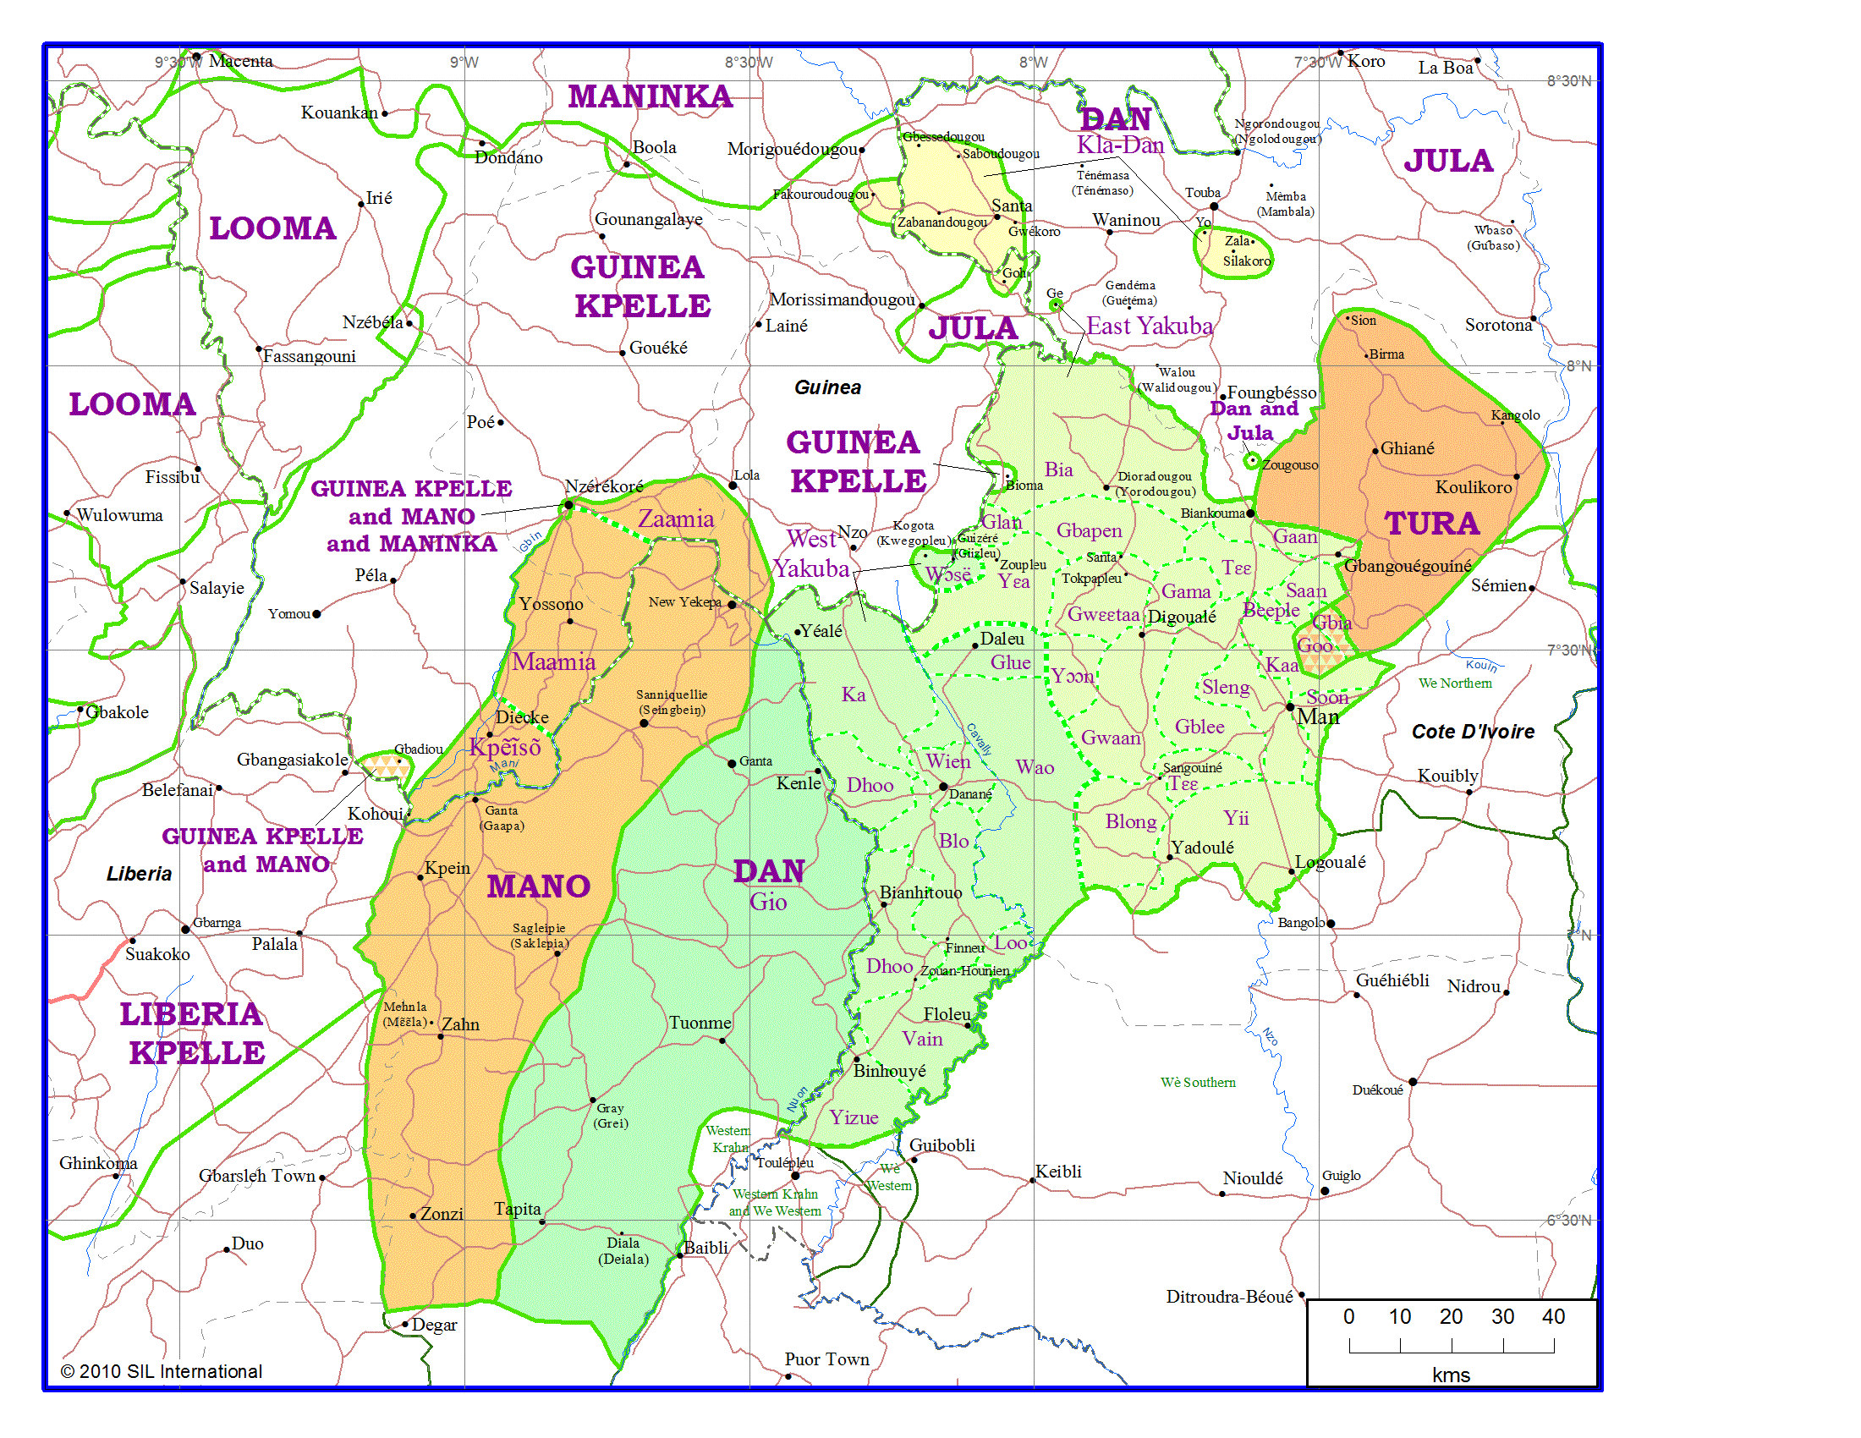
Dan-Gwɛɛtaa (Southern Mande)

Slide 13
Types of locative nouns in Dan-Gwɛɛtaa
The number: more than 50 in my dictionary (cf. about 770 nouns), toponyms not taken into account.
Two classes:
unvariables (do not modify their forms, but can be used in the post-verbal position without a postposition) – only 3 (bɔ̰̋ ‘initiation’, bɯ̋, blɯ̋ ‘bush’, ɗi̋ ‘mouth’);
with morphlogical cases (the great majority).

Slide 14
Morphological cases
result from fusion of nouns with postpositions or/and with the adverbial suffix -ɗɤ̄;
one locative lexeme may have several case forms;
the total number of cases is 6, however, there is no lexeme that would have forms of all the 6 cases.

Slide 15
The common case
Unmarked for some locatives (ya̰̋ ‘eye’, yʌ̰́ŋ̏ ‘sun’), marked by the suffix –ɗɛ̏ for some others. In the latter case, a common case locative noun form differs from the corresponding nouns:
kɔ́ɔ́ɗɛ̏ ‘house’ (the inner space) - kɔ́ ‘house’ (the building)
zɯ̄ɯ́ɗɛ̏ ‘behind’ – zɯ̄ ‘origin’.
-ɗɛ̏ comes back to the noun ɗɛ̏ ‘place’.
At least some common case forms have incorporated postpositions: gblɯ̋ɯ̏ɗɛ̏ ‘on the stomach’ < gblɯ̋ ɓȁ ɗɛ̏ (ɓȁ ‘on’).

Slide 16
The common case, syntactic functions
the nuclear arguments (subject, direct object)
the oblique, with a postposition:
Gbȁtȍ yɤ̏ mɛ̄-nȕ ɗȁ yā̰ā̰ɗi̋ɤ̋
NOM.M 3SG.EXI human-PL save-NTR yesterday
si̋ɤ̋ gɔ̏.
fire.CMM PP
‘Yesterday Gbato saved people from the fire’.
dependent noun in genitive-like nominal constructions.
Yà ɗó gṵ̋ŋ̋-ɗɛ̏ kwa̰̋ŋ̏-ɗɤ̄.
3SG.PRF go sacred.house-CMM compound-LOC
‘He went to the court of the sacred house’.

Slide 17
The locative case
the most frequent among the oblique cases (about ¾ of all the locative nouns);
rarely, suffixless;
most often, formed by the suffix -ɗɤ̄ (replacing the common case suffix -ɗɛ̏);
often enough, the noun base is also modified.
Common case Locative case Translation
ɓláȁɗɛ̏ ɓláā ‘farm, field’
gɛ̰̄ŋ̏ɗɛ̏ gɛ̰̄ŋ̄ɗɤ̄ ‘foot/feet, leg(s)’,
kèȅɗɛ̏ kèèɗɤ̄ ‘on the occiput’

Slide 18
The origin of the locative case form
seemingly, N + postposition ɓȁ ‘on’ or (less frequently) gɯ́ ‘in’ + a productive adverbial suffix -ɗɤ̄ (cf. wȁȁɗɤ̄ ‘imitation of the noise of rain’, tōŋ̄tōŋ̄ɗɤ̄ ‘never’, etc.).
In fact, -ɗɤ̄ can be characterized as a marker of the circumstantial function.
Therefore: gwḭ̀ŋ̄ɗɤ̄ ‘on the head’ < *gwḭ̀ŋ̏-ɓȁ-ɗɤ̄.

Slide 19
The use of the locative case
The oblique function:
Màŋ̀zíȉ wȍ yà dɔ̄ n̄ tőő-ɗɤ̄.
machine voice 3SG.PRF put 1SG.NSBJ ear-LOC
‘The noise of engines torments my ears’.
More rarely, dependent noun in a genitive-like construction:
kèè-ɗɤ̄ yȕȁ
occiput-LOC illness\IZF
‘disease of occiput’

Slide 20
The inessive case
Results from fusion of the noun stem with the postposition gɯ́ ‘in’.
Manifests itself most often as copying of the final vowel of the stem and extrahigh tone: si̋ɤ̋ ‘fire’ - si̋ɤ̋ɤ̋ ‘in the fire’, kó ‘one another’ – kőő ‘one in(to) another’.
Of rare occurrence: is attested for 9 locative nouns only.
In some contexts, in free variation with the locative case.

Slide 21
The superessive case
Second in frequency among the oblique cases (about ¼ of all the locative nouns).
Originates in the fusion of the noun stem with the postposition ɓȁ ‘on’ (a surface which is not necessarily flat and/or horizontal).
Manifests itself in copying and (often) modification of the stem vowel + tonal lowering at the end: kɔ́ → kɔ́ɔ̏ ‘house’, gɛ̰̏ → gɛ̰̏ɛ̰̏, gæ̰̏æ̰̏ ‘leg, foot’, sɛ̋ → síāā ‘land, earth’.

Slide 22
The adessive case
Attested in 2 lexemes only:
kɔ̏ → kɔ̏ɔ̏ ‘hand’
zḭ̄ā̰ā̰ → zḭ̄ȁ̰ȁ̰ ‘road’
Results from fusion with the postposition tȁ ‘on’ (a flat horizontal surface).

Slide 23
The comitative case
Results from fusion with the comitative – instrumental – equative – locative postposition ká.
Manifests itself as copying of the stem vowel and tonal raising:
kɔ̏ → kɔ̄ɔ̄ ‘hand’
gɛ̰̏ → gɛ̰̄ɛ̰̄ ‘leg, foot’
Attested on 6 lexemes only.

Slide 24
Plural forms for the oblique cases
For many locative nouns, plural forms cannot be derived for the locative case.
When they are accepted, various models are applied:
R-LOC-CMM-PL PP:
Wȍ dɔ̄-sīʌ̄ ble̋e̋-ɗɤ̄.
3SG.EXI stop-DUR farm.edge-LOC
‘They stopped at the edge of the farm’.
Wȍ dɔ̄-sīʌ̄ ble̋e̋-ɗɤ̄-ɗɛ̏ ɗṵ̏ gɯ́.
3SG.EXI stop-DUR farm-edge-LOC-CMM PL in
‘They stopped at the edges of the farms’.

Slide 25
Otherwise, just a common case form can be used:
kɔ́i̋ɗɤ̄ ‘at the hamlet’ → kɔ́i̋ɗɛ̏-nȕ gɯ́ ‘at the hamlets’
Some locative nouns may have variants of plural with or without suffixes:
ɓláā ‘in the farm.SG.LOC’ → ɓláā-ɗɛ̏-ɗṵ̏ gɯ́ ~ ɓláā-ɗṵ̏ gɯ́ ‘in the farms’

Slide 26
Neutralization of the locative case with determiners
Mīnʌ́ yā nʌ̀, ȁ gɔ̏ ɗɛ̋ ɗɤ́
man this FOC 3SG.NSBJ head leaf be
flɤ̋-sɯ̏ ká pɤ̂ɗɛ̏ yā’ gɯ́.
whiten-GER with village.CMM this-3SG.NSBJ in
‘This is the man whose hair turned grey in this village’.
(cf. a locative form without determiner:
Ȁ gɔ̏ ɗɛ̋ yà flɤ̋ pɤ̂ɗɤ̄ ~ plɤ́ɤ̄. ‘His hair has turned grey in the/a village’.)

Slide 27
Selectivity of the case forms
Case forms are no more mere equivalents of the combinations of nouns with postpositions.
Yà wlɤ̋ kṵ́ sɔ̰̋ɔ̰̋.
3SG.PRF mortar catch REFL.SG tooth.COM
‘He has bitten a mortar’.
Yà wlɤ̋ sɯ́ ɤ̄ sɔ̰̋ ká.
3SG.PRF mortar take REFL.SG tooth with
‘He has raised a mortar with his teeth’.

Slide 28
Bāā ɓā ȁ ɓō sɛ̋ɛ̋.
cassave ART 3SG exit earth.IN
‘Extract cassava from the earth’.
Ɗɛ̏kpɒ̀ɒ̀yȉ dō ká pɤ̂-ɗɛ̏ ɓá
day one with village-CMM certain
ɤ́ Ɓɔ̰̏ɔ̰̏si̋i̋-ɗṵ̏ gɔ̏ sɛ̋ gɯ́…
REL.3SG.CNJ Burkinabe-PL POSS.OBL earth in
‘One day, in a village in Burkina Faso…’

Slide 29
Possessive marker: case agreement?
Opposition of alienable and inalienable nouns (otherwise, free nouns and relational nouns). free / alienable nouns are connected to the possessor with a connector:
ɗʌ̰́ ɓȁ gwɛ̄ɛ̋ ‘child’s cassava’
Relational / inalienable are connected without connector:
ɗʌ̰́ gɛ̰̏ ‘child’s leg’

Slide 30
Two connectors
The default connector is ɓȁ (from the superessive postposition).
Yà ɤ̄ ɓā sɔ̄ pɛ̋ ɗȁȁ ká vi̋ȍȍɗɤ̄.
3SG.PRF REFL.SG POSS cloth split knife with snip-snap
He has cut his fabric with a knife by one sharp strike.
When a possessive construction with a head locative noun is in the oblique position, the connector gɔ̏ is used instead:
Yà ɗó ɤ̄ gɔ̏ pɤ̂ɗɤ̄.
3SG.PRF go REFL.SG POSS.LOC village.LOC
‘He went to his village,.

Slide 31
The connector gɔ̏: not only with locative case forms
With regular nouns (caseless):
Yɤ̏ gȁ ɤ̄ gɔ̏ ɗíȉ tȁ.
3SG.EXI die\NTR REFL.SG POSS.LOC bed on
He has died in his bed.
With locative nouns in cases other than locative:
Yà séŋ̏ zīɤ̄ Yɔ̏ gɔ̏ kɔ́ɔ̏.
3SG.PRF charcoal pass Yo POSS.LOC house.SUP
‘He left traces of charcoal on the wall of Yo's house’.

Slide 32
Competition between ɓȁ and gɔ̏
The possessive connector gɔ̏ can be always substituted by ɓȁ.
There seems to exist a pragmatic difference between both connectors: gɔ̏ is more formal, ɓȁ is more affectionate.
gɔ̏ is rather an autonomous marker of the oblique function (jointly with the possessive menaing), rather than a true case agreement marker.

Slide 33
Reduplication of the oblique case forms
In Dan-Gwɛɛtaa, reduplictaion of adverbs and postpositions is possible, with the meaning of intensity and/or duration of the situation.
(a) Kȁ yȁ ŋ̄ zɯ̏.
2PL.IMP sit 1SG.NSBJ around
‘Sit down around me’.
Kȁ yȁ ŋ̄ zɯ̏-zɯ̏.
2PL.IMP sit 1SG.NSBJ around~INT
‘Sit down around me (in a tight circle)’.

Slide 34
The same model of reduplication for the locative nouns
only oblique case forms can be reduplicated, never a common case form;
the locative case form can omit the suffix -ɗɤ̄;
the reduplications expresses a characteristics of the predicate.

Slide 35
Intensive character of the action:
yɤ́ zȉɤ̏ kɤ̀ ɗɛ̋ɛ̋-ɗɛ̏
CONS.3SG.CNJ pass\NJ again public.square-CMM
ble̋e̋-ɗɤ̄ …
farm.edge-LOC
‘… he passes at the bord of the public square…’.
Á ɗō ɗɛ̄ŋ̄-ɗɤ̄, ā kʌ̄
1SG.CNJ go\JNT hamlet-LOC 1SG.EXI RETR
zȉɤ̏ ble̋e̋~ble̋e̋ á dɤ̄ŋ̄-ɗṵ̏
pass\NTR farm.edge.LOC~INT 1SG.CNJ trap-PL
gȁ.
look\JNT
‘When I went to the farm, I passed by the edge very meticulously and examined the traps’.

Slide 36
Permanent action/situation
Ɓā̰ gbɛ̰̂-ɗʌ̰́ yɤ̏ kwɛ̰̋ŋ̏-ɗɤ̄.
1SG.POSS dog-DIM 3SG.EXI yard-LOC
‘My dog remains constantly in the yard’.
Ɓā̰ gbɛ̰̂-ɗʌ̰́ yɤ̏ kwɛ̰̋ŋ̏-ɗɤ̄~kwɛ̰̋ŋ̏-ɗɤ̄,
1SG.POSS dog-DIM 3SG.EXI yard-LOC~INT
yáá ɗó ɗɛ̏ ɓá gɯ́.
3SG.NEG.IPFV go place certain in
‘My dog is constantly in the yard, it does not go anywhere’.

Slide 37
Reduplication of obliques with postpositions
Yɤ̏ zȉɤ̏ ɤ̄ ɓȁ kwɛ̀ɛ̀ ká yʌ̰́ŋ̏ ɗɛ̏.
3SG.EXI pass\NEUT REFL.SG POSS load with sun before
‘He passes with his load under the sun’.
Bɛ̀ɗɛ̋ gā ɗɔ̋ɔ̋-dɔ̄-ɓɛ̰̏-ɗṵ̏ wȍ
drug bone market-stand-human\IZF-PL 3PL.EXI
zȉɤ̏ ȁ ká yʌ̰́ŋ̏ ɗɛ̏ yʌ̰́ŋ̏ ɗɛ̏.
pass\NTR 3SG.NSBJ with sun before sun before
‘Drug sellers pass all the time under the sun’.

Slide 38
What is the status of the post-verbal complexes apt to reduplicate?
yʌ̰́ŋ̏-ɗɛ̏ ‘under the sun’ (litt. ‘before the sun’),
yʌ̰́ŋ̏-gɯ́ ‘in the daytime’ (litt. ‘in the sun’),
kɔ̏-ɗi̋ɤ̋ ‘in the hands’ (litt. ‘before the hand’),
sɔ̰̋-pi̋ɤ̋ ‘by the teeth’, etc.
locative nouns?
adverbs?
compound postpositions?

Slide 39
Conclusion
The case system in Dan-Gwɛɛtaa is emergent:
the paradigm is globally defectuous (not a single locative noun with a full paradigm; 4 out of 6 cases are rare; poor compatibility of oblique cases with plural marker and other determiners);
only peripheral cases are marked, the nuclear cases are not distinguished.

