Slide 1
Functions of the 3sg Possessive in Beserman Udmurt: Corpus Analysis
Timofey Arkhangelskiy (National Research University Higher School of Economics)
timarkh@gmail.com
Maria Usacheva (Moscow State University)
mashastroeva@gmail.com
Research was supported by the RFH grant 16-24-17003 “Интегральный анализ именной группы в финно-угорских языках: поддержание референции и кодирование информационной структуры высказывания”

Slide 2
Possessives in Udmurt
Udmurt has full paradigm of possessives
3sg possessive is special, as apart from having purely possessive functions (see Едыгарова 2010), it often means something other than a prototypical possessive relation
Only 3sg possessive is used in case compounding and for marking contrastive focus on adjectives:
(1) kyz-ze / *kyz-de kor-de uli-ja-z pun
thick-p.3sg.acc / thick-p.2sg.acc log-p.2sg.acc bottom-ill-p.3sg put.imp
‘Put the thick log to the bottom.’

Slide 3
3sg possessive
The fact that p.3sg has developed non-possessive meanings in Udmurt and other Uralic languages has been often mentioned in the literature
[Лыткин et al. 1974], [ГСУЯ 1962:84-85], [Winkler 2001: 29], [Тепляшина 1970: 176]
[Кузнецова 2012]
[Simonenko 2014] for Komi, Khanty and Mari
[Tánczos 2016]
Sometimes p.3sg evolves into a definiteness marker (cf. Eastern Armenian)

Slide 4
3sg possessive
Example of a 3sg possessive with a discourse function:
(2) pios.murt-ez baš’t-iz baton
guy-p.3sg take-pst.3sg loaf
‘The guy took a loaf.’
It can attach to different parts of speech, but we only looked at nouns (including relational nouns)

Slide 5
Other possessives
2sg possessives can also be used in non-possessive functions:
(3) vaj so-ize=no gozə̑-de
bring.imp that-p.3sg.acc=add rope-p.2sg.acc
‘Bring me that rope as well’ [the rope does not belong to the addressee]
And, occasionally, 1sg possessives as well:
(4) ad’ami-je kə̑č’eke korka pə̑r-iz
person-p.1sg some house.ill enter-pst.3sg
‘That man [I was talking about] went into some house.’
We will not cover this topic here

Slide 6
What we did
We want to know when and how often p.3sg marker has non-possessive functions and what are the factors that trigger its appearance
We annotated 12 texts of different genres from the Beserman corpus (collected in Shamardan, Udmurtia, in 2003–2016), which gave us about 2,000 nouns
Each noun was annotated with a number of parameters (features)
Then machine learning algorithms were used to see how well this set of parameters predicts the appearance of p.3sg and which parameters are most important

Slide 7
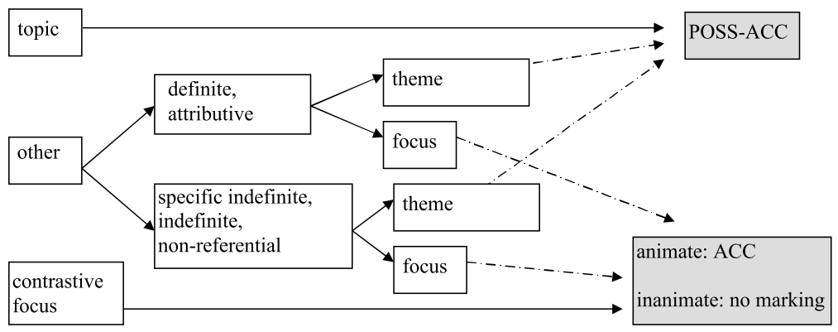
What we did
[Serdobolskaya, Toldova 2012] for Pechora Komi:

Slide 8
Features
referential status (def, weak, ref_indef, indef, generic,...)
semantic class (rn, bp, kin, ..., other)
animacy
alienability
uniqueness
syntactic position (subj, DO, oblique, NPDep, addr, pred)
topic / focus
referential distance, distance to first occurrence, topic persistence
the case of the dependent (if any)
protagonism
possessive relation

Slide 9
NP structure
Two types of NPs with nominal dependents are possible in Beserman:
N N
(5) korka koš’ag
house window
N-gen N-p.3sg
(6) korka-len koš’ag-ez
house-gen window-p.3sg

Slide 10
NP structure
With relational nouns as heads, the (discourse) possessive marker in N N can attach to the head or the dependent:
(7) korka-je dor-e / korka dor-a-m
house-p.1sg near-ill / house near-ill-p.1sg
‘to my house’
In N-gen N-p.3sg, it can attach only to the dependent, as the slot on the head is already occupied:
(8) korka-je-len dor-a-z
house-p.1sg-gen near-ill-p.3sg
‘to my house’

Slide 11
NP structure
We counted [N RelN] as one occurrence:
korka 0
korkajez 3sg
korka+vələn 0
korkajez+vələn 3sg
korka+vəlaz 3sg
korkajezlen+vəlaz 3sg

Slide 12
NP structure
Ordinary nouns: 1468 total, 75% non-possessive
RelNPs: 130 total, 77% non-possessive
It seems that possessive marking is independent from the NP type and from the choice of the host within [N RelN]
Annotating heads and dependents in RelNPs separately would skew the results

Slide 13
Distribution of possessives in texts
no possessive: 65.6%
1: 3.9%
2: 2.5%
3: 28%
It is often hard to tell whether any given occurrence of p.3sg is “possessive” or “discourse”:
“true possessive”: 24%
“discourse possessive”: 60%
???: 16%

Slide 14
“True possessives”
The genitive case of the dependent always triggers the appearance of the possessive marker
Well, almost always:
(9) sakar odig kə̑l’-iz=na mə̑nam
sugar one remain-pst.3sg=else I.gen
‘as for the sugar, I have only one left’
In all 3 examples we have, the head is in the topic
That said, we discard “true possessives” and only look at the rest

Slide 15
Overall prediction quality
Machine learning: an algorithm looks at the annotated data (“training dataset”) and tries to learn rules so that it could predict the target variable (whether discourse p.3sg appears on a noun) based on other parameters
After that, we check how well the rules have been learned by applying them against a separate test sample
We applied 3 algorithms: SVM, decision tree, random forest
SVM and random forest give 84% correct answers
Therefore, our set of parameters explains when the p.3sg appears fairly well, but there are probably some other factors or free variation

Slide 16
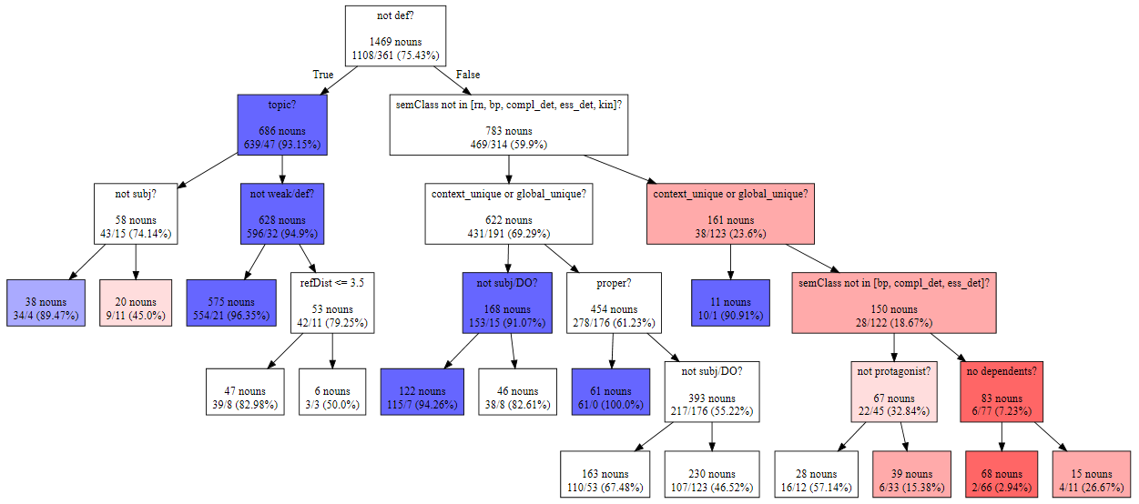
Decision tree

Slide 17
Feature importance
1. semantic class (0.23)
2. referential status (0.19)
3. referential distance (0.17)
4. uniqueness (0.13)
5. syntactic position (0.11)
...

Slide 18
Feature importance
alienability, animacy, protagonism, distance to the first mention proved to be irrelevant
topic persistence gave inconsistent results with different window lengths
topicality seems to be important (66% non-possessives in topic, 77% in focus), but we have low inter-annotator agreement

Slide 19
Animacy
Animacy was found to be important for the choice of ACC/0 marking of the DO in Pechora Komi (Serdobolskaya, Toldova 2012)
In our model its predictive strength was very low
No hierarchy: people > inanimate >> animate
Other factors seem to interfere (toy animals/people; animals as protagonists in fairy tales)

Slide 20
Syntactic position
The probability of being marked decreases along the hierarchy:
 | no possessive | p.3sg
subject | 65% | 35%
direct object | 71% | 29%
oblique | 78% | 22%
nominal dependent | 90% | 10%

Slide 21
Definiteness
Whether the referential status of a noun is “definite” is important
Nouns that are not definite usually (93.5%) do not have possessive
Still, 60% of definite nouns also do not have possessives (50% if you count the “true possessives”)
Is it the case that p.3sg is blocked by other factors (as e.g. in English the definite article is incompatible with demonstrative pronouns and is not used with proper nouns)?

Slide 22
Definiteness: demonstratives
Demonstrative pronouns in Uralic languages usually block discourse possessive marking (folklore)
This is not the case in Beserman:
 | no possessive | p.3sg
with so ‘that’ / ta ‘this’ | 61% | 39%
definite without so/ta | 60% | 40%

Slide 23
Definiteness: uniqueness
Items that refer to unique objects usually do not have possessive marking
(more or less) globally unique: sun, police, army
unique in the given context (the village or the river when describing the life in that village or during experiments)
92% nouns in each of the two classes are used without possessives

Slide 24
Definiteness: proper names
In our sample, all 68 proper names are used without possessives
In fact, using p.3sg with proper names is not prohibited:
(10) kakoj, mon lada-ze ej=na aǯ’-ə̑l!
(rus) I.nom PN-p.3sg.acc neg.pst.1sg=yet see-iter
[Have you seen Ladaʼs daughter?] — I havenʼt even seen Lada herself yet!
But p.3sg is used here for reasons other than marking definiteness

Slide 25
Definiteness
Even if we remove unique objects and proper names from the sample, still 42% of definite nouns will not be marked
Therefore, p.3sg cannot be described as the definiteness marker
Out of these, subjects and direct objects are more likely to be marked

Slide 26
Topicality and referential distance
The p.3sg marker attaches to topic nouns more frequently
This trend is even more pronounced for subjects
Referential distance: number of clauses between the current and the previous mention of the object in discourse
With the increase if the distance, the object loses its activation

Slide 27
Topicality and referential distance
It is evident that difference between, say, 15 and 16 clauses is less significant than between 2 and 3
We divided this parameter into segments of exponentially growing lengths:
segment | 0 | 1 | 2 | 3 | 4 | 5 | 6 | 7 | 8
ref. dist. | 0 | 1 | 2-3 | 4-7 | 8-13 | 14-23 | 24-40 | 41-68 | 69-...

Slide 28
Topicality and referential distance

Slide 29
Topicality and referential distance

Slide 30
Topicality and referential distance
The probability of possessive marking increases as referential distance increases from 0 through 2 (24% → 40%), then stays at the same level, and then drops little by little
This indicates that p.3sg is used to reactivate the object that was mentioned at some point earlier, but lost its activation
This can happen to both definite and indefinite nouns
Nouns that need such reactivation are often topical
The drop on greater distances can be explained by the fact that if the object was last mentioned too long ago, it loses its activation completely and has to be reintroduced

Slide 31
Contrast
p.3sg is very frequent in contrastive focus:
(11) a gord mašina-ez-len odig pal es-ez paš’=uk?
and red car-p.3sg-gen one side door-p.3sg open=emph
‘[They also opened both doors of the white car.] — And is one of the red car’s doors open?’
Among nouns that denote one object out of a small set, only 31% lacked possessive marking
In such cases, p.3sg can be described as having possessive semantics, this set being interpreted as the possessor

Slide 32
Conclusions - 1
“discourse” p.3sg is more frequent than the “possessive” one
There is no single parameter that explains its use
Referential status, semantic class of the noun, syntactic position, referential distance, uniqueness, and topicality predict the appearance of p.3sg with 84% accuracy
Animacy, alienability, topic persistence, and distance to first mention do not influence the probability of p.3sg marking
Assignment of p.3sg to a RelNP seems to be independent from the choice of the host within that phrase

Slide 33
Conclusions - 2
Referential status of the noun is important, but p.3sg has not yet evolved into a definiteness marker
p.3sg is used for reactivating the topic that was mentioned previously but lost activation (even for indefinite nouns), especially if it is in the subject position
p.3sg is used in contrastive contexts, where it can be interpreted as marking a possessive relation with respect to a small set

Slide 34
References
Serdobolskaya, N., Toldova, S. Information structure at odds with discourse factors: evidence from Finno-Ugric differential object marking. Handout of the talk given at Categories of Information Structure across Languages, Nijmegen, Netherlands, 9.11.2012–10.11.2012.
Simonenko, A. Microvariation in Finno-Ugric Possessive. In Proceedings of the 43rd annual meeting of the North East Linguistic Society, Vol. 2, pp. 127-140, 2014.
Tánczos, O. Towards a unified account of the suffix -ez/jez in Udmurt. Talk at SLE 2016
Winkler E. Udmurt, vol. 212 of Languages of the World. Lincom Europa, Munich, 2001
Едыгарова, С. Категория посессивности в удмуртском языке. PhD thesis. Tartu Ülikooli Kirjastus, 2010.
Кузнецова, А. И. Кумуляция грамматических значений в агглютинативных показателях: дейктические функции посессива в уральских языках // Кузнецова А. И. (отв. ред.). Финно-угорские языки: Фрагменты грамматического описания. М.: 2012.
Лыткин, В. И., Майтинская, К. Е., Редеи, К. (отв. ред.). Основы финно-угорского языкознания (вопросы происхождения и развития финно-угорских языков). Москва: Наука, 1974.
Перевощиков П. Н. (отв. ред.). Грамматика современного удмуртского языка. Фонетика и морфология. Ижевск: Удмуртское книжное издательство, 1962.
Тепляшина Т. И. Язык бесермян. М.: Наука, 1970.
Corpus of spoken Beserman: http://beserman.ru/corpus/

Slide 35
Thank you!

