Slide 1
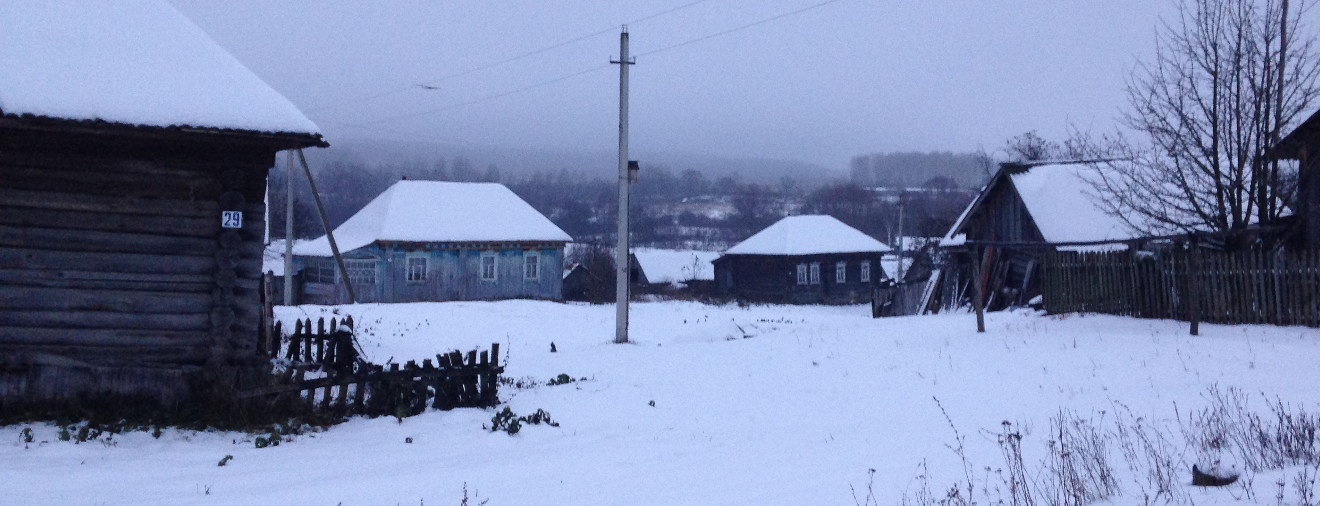
Some observations on Moksha passive
Ivan Stenin, National Research University Higher School of Economics
Daria Zhornik, Lomonosov Moscow State University

Slide 2
Structure of our talk
Canonical passive in Moksha
Other passive constructions
Constraints on passive constructions
Modality in Moksha passive sentences
Some typological parallels
Conclusions
XIII Conference on Typology and Grammar for Young Researchers
Saint Petersburg, Institute for Linguistic Studies, Russian Academy of Sciences
24–26 November, 2016

Slide 3
Passive
Transitive clause in (1) and passive one in (2).
(1) vas'ɛ-n' s'embə kel'g-əz'
Vasya-gen all like-pst.3.o.3.pl.s*
‘Everyone loved Vasya’.
(2) vas'ɛ (s'embə-n'd'i) kel'g-əv-s'
Vasya all-dat like-pass-pst.3sg
‘Vasya was loved (by everyone)’.
Argument marking: initial DO SUBJ (nominative NP), initial SUBJ optional adjunct (dative NP).
Agreement: only the subject of a passive is indexed in a verb.
* Glosses are simplified as compared with the actual glossing rules used in the Moksha expedition project.

Slide 4
Variety of constructions
Apart from canonical passive in (2) and (3), there are also other possible constructions with -(ə)v-.
(3) mon'd'ejən t'ɛči pid'-əv-s' l'ɛm
I.dat today cook-pass-pst.3sg soup
‘I cooked a soup today’.
(4) mon t'ɛči pid'-əv-ən' l'ɛm
I today cook-pass-pst.1sg soup
‘I cooked a soup today’.
In (4), the verb contains passive morphology, however, it agrees with the initial subject (in nominative).
The meanings of (3) and (4) seem to be the same at first sight.
later: Dat-Nom
later: Nom-Nom

Slide 5
Variety of constructions
Intransitive verbs also combine with the suffix -v-.
Two possible outcomes: initial subject either retains its nominative case (5) or changes it to dative (6).
(5) mon vor'gəd'-əv-ən' s'ɛ vast-t' ezdə
I escape-pass-pst.1sg this place-def.sg.gen in.abl
‘I escaped from this place’.
(6) mon'd'ejən vor'gəd'-əv-s' s'ɛ vast-t' ezdə
I.dat escape-pass-pst.3sg this place-def.sg.gen in.abl
‘I escaped from this place’.
In the last case, the verb takes default agreement (3sg).
The meanings of (5) and (6) seem to be the same at first sight.
later: Nom
later: Dat

Slide 6
Syntactic properties
Common syntactic tests also do not reveal any differences between properties of the dative and nominative subject NPs.
Control of reflexive pronouns:
(7) maša-n'd'i / maša šta-v-s' es' panar-c
Masha-dat Masha wash-pass-pst.3sg refl.poss dress-3sg.poss.sg
‘Masha washed her (own) dress’.
Control of PRO in subordinate clauses:
(8) pet'ɛ-n'd'i / pet'ɛ kočka-v-s' jarmak rama-m-s mašina
Petya-dat Petya collect-pass-pst.3sg money buy-inf-ill car
‘Petya collected money to buy a car’.

Slide 7
Our goal
There are yet other constructions with -v- derivatives in Moksha (e. g. anticausative).
We will focus just on 4 constructions illustrated above and try to answer the following questions:
  How can we distinguish between 2 constructions from transitive verbs and 2 from intransitive ones?
  What is the function of the passive marker in these cases?
  Does it contribute something to the semantics of a clause?
  Do we find something similar in other languages?

Slide 8

Our constructions

Slide 9
Constraints on 1st argument
Despite the seeming similarity of the constructions in question there are a few (mainly semantic) parameters that allow us to distinguish between them.
Nom-Nom does not accept an inanimate 1st participant.
(9) *mašinka-s' / mašinka-t'i višk-stə sta-v-i panər
machine-def.sg machine-def.sg.dat strong-el sew-pass-npst.3sg dress
‘A machine can sew a dress quickly’.
(10) maša / maša-n'd'i višk-stə sta-v-i panər
Masha Masha-dat strong-el sew-pass-npst.3sg dress
‘Masha can sew a dress quickly’.
The same is presumably true of Dat.

Slide 10
Constraints on 2nd argument
Nom-Nom does not accept a definite 2nd participate.
(11) vas'ɛ luv-əv-s' kn'iga / *kn'iga-s'
Vasya read-pass-pst.3sg book book-def.sg
‘Vasya managed to read a / *the book’.
(12) vas'ɛ-n'd'i luv-əv-s' kn'iga / kn'iga-s'
Vasya-dat read-pass-pst.3sg book book-def.sg
‘Vasya managed to read a / the book’.

Slide 11
Constraints on predicate
Dat is not possible with a patientive intransitive predicate.
(13) *mon'd'ejən ban'a-sə l'ivəs'kəd-əv-s'
I.dat sauna-in sweat-pass-pst.3sg
Expected meaning: ‘I managed to sweat in Russian baths’.
Nom-Nom and Dat are not possible with an experiential predicate.
(14) maša-n'd'i / *maša nɛjə-v-i loman'
Masha-dat Masha see-pass-npst.3sg man
‘Masha can see a man’.
(15) vas'ɛ / *vas'ɛ-n'd'i af ken'ard'-əv-i
Vasya Vasya-dat neg be.happy-pass-npst.3sg
‘Vasya cannot be happy’.

Slide 12
Our constructions in comparison
Table 1. Constraints on different constructions
 | Dat-Nom | Nom-Nom | Dat | Nom
Inanimate 1st participant | + | - | - | +
Definite 2nd participant | + | -
Experiential predicate | + | - | - | +
Intransitive patientive predicate |  |  | - | +

Slide 13
Our constructions in comparison
Nom-Nom and Dat appear to have strikingly similar (practically the same!) constraints.
On the contrary, Dat-Nom and Nom constructions do not have any constraints whatsoever.
Any -v- derivative formed from a transitive verb can appear in Dat-Nom regardless of its surroundings.
Likewise, -v- derivatives formed from intransitive verbs may freely appear in Nom.
Nom-Nom and Dat constructions are significantly more restricted than Dat-Nom and Nom respectively.

Slide 14
Further constraints
Dat cannot be formed with derivatives of labile verbs, as the transitive interpretation “wins” (narams ‘to shave someone / oneself’).
The construction is perceived as Dat-Nom and arises the need of adding a 2nd participant.
(16) vas'ɛ nara-v-s'
Vasya shave-pass-pst.3sg
‘Vasya managed to shave himself’.
(17) vas'ɛ-n'd'i nara-v-s' *(pet'ɛ)
Vasya-dat shave-pass-pst.3sg Petya
‘Vasya managed to shave Petya’.
Expected meaning: ‘Vasya managed to shave himself’.

Slide 15
Further constraints
The impossibility of Nom-Nom with transitive experiential predicates might be explained in a similar way.
Nom-Nom and Dat constructions indeed have significant restrictions, which result in their infrequent appearance in speech.
We believe that these constructions appeared at a later stage of development of -v- derivatives, probably as a result of analogy.
Furthermore, there is actually much of variation within the language community: a considerable part of speakers do not accept Nom-Nom (and some speakers also Dat) at all.

Slide 16
Transitive passive
In Nom-Nom construction, the 1st argument is not demoted and the 2nd one is not promoted.
Actually, what we find here is a “passive” derivative in a transitive clause, which is rather unexpected (DO in Moksha remains unmarked if it is indefinite).
(18) maša pid'-i lɛm
Masha cook-npst.3sg soup
‘Masha is cooking soup’.
(19) maša pid'-əv-i lɛm
Masha cook-pass-npst.3sg soup
‘Masha can cook soup’.

Slide 17
The taste of -v-
One can find the same contrast in Nom.
(20) maša koməc'
Masha jump.pst.3sg
‘Masha jumped’.
(21) maša komət'-əv-s'
Masha jump-pass-pst.3sg
‘Masha managed to jump’.
The difference between (18) and (19), (20) and (21) lies in the modal semantics added by -v-.

Slide 18
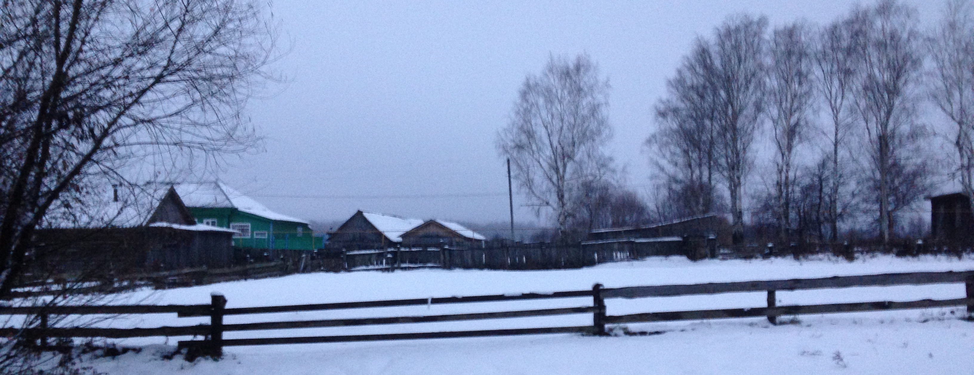
Our modality

Slide 19
When we meet our modality
Passive verbs are modalized expressions in our constructions, except:
  Dat-Nom with unexpressed subject;
  Dat-Nom from experiential predicates.
(22) val'mɛ-s' pan'ž-əv-s' štobə aru-ftə-m-s komnata-t'
window-def.sg open-pass-pst.3sg in.order clear-caus-inf-ill room-def.sg.gen
‘The window was opened in order to clean air’.
(23) petɛ-n'd'i maša kel'g-əv-i
Petya-dat Masha like-pass-npst.3sg
‘Petya likes Masha’.
For transitive verbs, it is namely these 2 environments that lack explicit agent: in (22) it is omitted, in (23) the dative NP is experiencer.

Slide 20
Possible interpretations
In all other cases we find additional semantics which can usually be described as modal (~ ‘to manage’ or ‘to be able to’).
However, -v- derivatives allow other interpretations as well.
(24) mon nara-v-ən'
I shave-pass-pst.1sg
a. ‘I managed to shave myself (although the razor was blunt)’.
b. ‘I finally shaved myself (and earlier there was no water)’.
c. ‘I finished shaving myself (and am ready to go)’.
Three different translations of such constructions are possible.
Do they truly reflect distinct meanings of the suffix?
We believe that this diversity arises (mainly) from the context.

Slide 21
Possible interpretations
The completive interpretation ‘to finish’ is possible for weak telic predicates; the modal one ‘to manage, to be able to’ for agentive ones; the ‘finally’ interpretation is possible for all predicates.
Some predicates such as agentive narams in (24) allow all three interpretations, some have only two or one of them.
See, for instance, patientive kos'kəms ‘to dry (intr.)’ which is a strong telic predicate in Moksha and cannot describe a process in the past.
(25) prost'ina-t'n'ə kos'k-əv-s'-t'
sheet-def.pl dry-pass-pst.3-pl
a. ‘The sheets finally dried.’
b. *‘The sheets finished drying’.
c. *‘The sheets managed to dry’.

Slide 22
Recursive derivation
We suppose that if the three interpretations listed above truly represented separate meanings, it would be possible to use recursive attachment of the suffix to combine various meanings of -v-, such as ‘to finally manage’.
However, we do not find any examples of this kind, whereas there are other cases, when recursive -v- derivation is possible.
The first -v- must indeed bear a separate meaning (such as the autocausative one in the example below).
(26) s'embə radn'ɛ-t'n'ə kočka-v-əv-s'-t' mar-s
all relative-def.pl gather-pass-pass-pst.3-pl pile-ill
‘All the relatives managed to gather together (is was difficult)’.

Slide 23
Recursive derivation
Or it does not express any semantics (!) and serves to form a prototypical passive construction.
(27) pet'ɛ-n'd'i af kel'g-əv-i maša, no kel'g-əv-əv-i
Petya-dat neg love-pass-npst.3sg Masha но love-pass-pass-npst.3sg
‘Petya does not love Masha, but he will be able* to love her’.
The second -v- in such cases introduces one of the interpretations illustrated before.
* The verb kel'gəms ‘to love’ is not agentive, however, ‘to be able’ is used in the translation. So we have some shift here.

Slide 24
Modality in Moksha
Rather heterogeneous system: pass & nmlz suffixes, lexical verb maštəms ‘to be able’, er'avəms ‘to need’ (lexicalized passive derivative of er'ams ‘to live’), particles, Russian adverbs, code-switching.
Modal force is settled lexically.
Epistemic / non-epistemic modality expressed via distinct strategies.
Modal flavours are not usually differentiated in necessity modals.
Table 2. Modal forces and modal flavours in Moksha (in terms of Matthewson (in press))
 | Circumstantial | Deontic | Epistemic
◊ | -əv, maštəms, (может, можешь...) | (možna) | particles
□ | -ma, er'avəms, (savəms) | -ma, er'avəms | we don’t know :)

Slide 25
Passive suffix vs. maštəms
Both passive derivative and maštəms can be translated as ‘to be able’.
However, these ones are different types of ability.
Maštəms describes generic participant-internal ability (individual-level state).
-v- is usually used when we speak about the ability to perform a single action.
(28) A: uj̊-t'! B: mon af uj-əv-an
swim-imp.2sg I neg swim-pass-npst.1sg
A: a mes? B: da af mast-an uj-əmə
but why well neg can-npst.1sg swim-inf
‘A: Swim! B: I won’t be able to swim (now)’.
‘A: But why? B: Well, I can’t swim (at all)’.

Slide 26
Actuality entailments of ability modals
Ability modals + perfective aspect = implicative inference (“actuality entailment”).
Cf. passé composé (29) vs. imparfait (30) in French.
(29) Jean a pu prendre le train, #mais il ne l’a pas pris.
John has can.pst.pfv take the train but he not that.has taken
‘John managed to take the train, #but he did not take it’.
(30) Jean pouvait prendre le train, mais il ne l’a pas pris.
John can.pst.ipfv take the train but he not that.has taken
‘John could have taken the train, but he did not take it’.
A good deal of literature: Bhatt (1999), Hacquard (2006, 2009, 2014), Mari & Martin (2007), Mari (ms.), just to name a few.

Slide 27
Moksha passive in the present tense
There are no perfective vs. imperfective pairs, but “plain” vs. frequentative* verbs.
(31) c'ora-n'ɛ-s' jaka-v-i
boy-dim-def.sg go.freq-pass-npst.3sg
‘The boy can go (after he was ill)’.
(32) son višk-stə mol'-əv-i no jaka-j valəm
he intense-el go-pass-npst.3sg but go.freq-npst.3sg slow
‘He can go rapidly but (usually) goes slowly’.
(33) son mol'-əv-i kud-u
he go-pass-npst.3sg home-lat
‘He is able to go home (and succeeds in it, though he is lame)’.
(potential) ability
non-actualized ability
actualized ability
* This is the only suppletive pair in Moksha that is used in the examples above.

Slide 28
Moksha passive in the past tense
Two major functions of -l- (“second past tense”): past habitual (competes with simple past tense) and conditional.
(34) ingəl'i min' jaka-v-əl'-əmə / ^{ok}jaka-v-əmə oš-u
formerly we go.freq-pass-pqp-pst.1pl go.freq-pass-pst.1pl city-lat
‘Earlier, we could go to the city (and did so, but now we can’t)’.
(35) mon is'ak mol'-əv-əl'-ən' (bə)/#mol'-əv-ən' ul'c'a-v
I yesterday go-pass-pqp-pst.1sg go-pass-pst.1sg outdoors-lat
‘Yesterday, I could go outside (but it was too cold, so I didn’t)’.
In case of non-actualized ability in the past, one needs -l- on top of a passive verb.
past habitual, actualized ability
episodical, non-actualized ability = conditional

Slide 29
Moksha passive in the past tense
Negation test:
(36) mon mol'-əv-ən' saldak-ən' il̥'t'-əmə
I go-pass-pst.1sg soldier-gen see.off-inf
no iz'-ən' #mol'-ə / ^{ok}s'im-ə
but neg-pst.1sg go-cn drink-cn
a. ‘I was able to go to see off the soldier, but I didn’t drink.’
b. *‘I was able to go to see off the soldier, but I didn’t go.’
We always find actuality entailments in the past tense with -v- derivatives in all our constructions.
episodical, actualized ability

Slide 30
Typological parallels: Indo-Aryan
In addition to regular passive, passive constructions may exhibit some modal meaning (“inabilitative” passive); cf. ex. from Hindi.
(37) mujh-se kuchh-bhii kah-aa nahĩ: gay-aa
I.obl-instr something-even say-pfv neg pass-pfv
‘I couldn’t say anything’ (see Bhatt (2003) and references therein).
As well as in Moksha, the modal meaning vanishes when the demoted subject is omitted.
(38) kuchh-bhii kah-aa nahĩ: gay-aa
something-even say-pfv neg pass-pfv
a. ‘Nothing was said’.
b. *‘Nothing could be said’.

Slide 31
Typological parallels: Indo-Aryan
However, in Hindi inabilitative meaning appears only is affected environments: under negation, in implicit negation questions, conditionals, with only, adverbs of difficulty or unlikelihood etc.
Unlike most other Indo-Aryan languages, Kashmiri (Dardic sub-group) does not have any restrictions on the availability of (in)ability reading (Srishti & Bhat 2014).
It is readily formed from transitive and intransitive predicates, but cannot be formed from stative predicates.
(39) *farooq-ni zaryi aayi-nI bochi lag-nI
Farooq-gen by come-prf-neg hunger happen-inf.obl
Expected meaning: ‘Farooq was not able to be hungry.’

Slide 32
Conclusions
There is normal passive in Moksha, but only in constructions with experiential verbs or omitted agent.
In all other cases, irrespective of actual argument structure, -v- contributes something to the semantics of a clause.
We believe that -v- in our constructions is an ability modal with actuality entailments in the past tense.
There are some typological parallels for similar development of modal meanings of passive, for example, in Indo-Aryan...
But in Moksha modal meaning does not require affected environments!
And passive is formed with a suffix :)

Slide 33
Conclusions
We see that common syntactic tests do not reveal any differences between our constructions.
The constraints on their use are mainly semantic, for example, animacy or definiteness of arguments.
It might be the case that the modality introduced by the -v- suffix in different constructions is a little bit different.
However, this is the subject of yet another talk :)

Slide 34

Thank you for your attention!

