Slide 1
Asymmetry of negation
Evidence from Barguzin Buryat
Rossyaykin P., Zelenskii D.
Moscow State University

Slide 2
Barguzin Buryat
Altaic > Mongolic > Eastern > Oirat-Khalkha > Khalkha-Buryat > Buryat > Barguzin dialect
≈ 283 000 speakers (Buryat; much less native speakers in fact)
Mostly bilingual
Barguzin dialect is spoken in Barguzin and Kurumkan districts of the Republic of Buryatia, Russian Federation
Data collected in Baraghan village, Kurumkan district

Slide 3
Main typological characteristics
(shared within Buryat):
Vowel harmony by features [back] and [round];
Strictly head-final;
Agglutinative;
Facultative possessive markers, including reflexive possessive, combined with genitive case;
Nominative-accusative-dative case marking

Slide 4
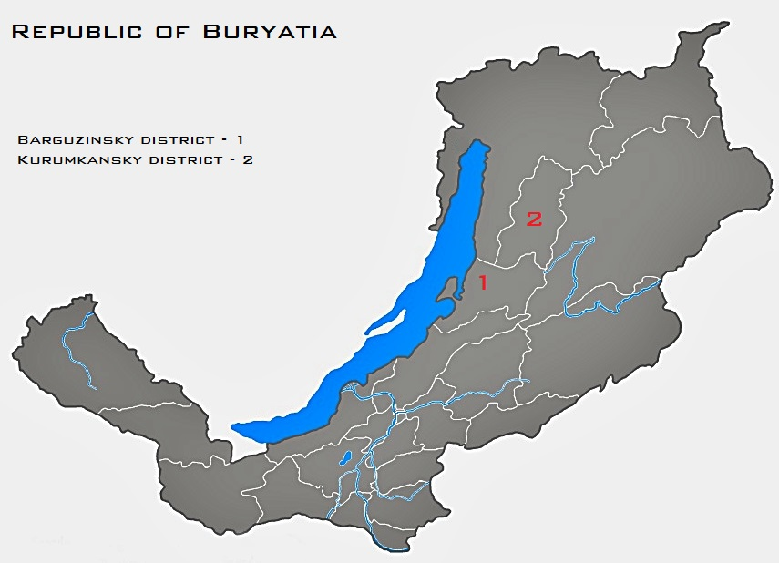

Slide 5
Negation markers in Barguzin
There are four productive negation markers in Barguzin Buryat: -gʉi, bʉ= (prepositive), =bɘʃɘ and =ʉgi:
bʉ= is used with all the non-indicative verbal forms (such as imperative and hortative) and with them only
(1) aba bʉ jɘrɘ-hɘi
father proh come-opt
‘I’d like the father not to arrive’
(2) *aba jɘrɘ-hɘi-gʉi
father come-pot-neg
‘I’d like the father not to arrive’

Slide 6
=ʉgi: (existential negation)
=ʉgi: is used as a negative existential predicate
(3) bato jɘrɘ-xɘ-gʉi bato ʉgi:
Bato come-pot-neg Bato neg.ex
‘Bato will not come. Bato doesn’t exist’
(4) doktor ʉgi:
doctor neg.ex
‘Doctor is absent / There is no doctor’
Sometimes can be interpreted as homonymous to -gʉi (i.e. standard negation) but never produced in this function

Slide 7
Standard negation
We believe -gʉi to be the marker of standard negation (as defined in (Miestamo, 2005))
=bɘʃɘ is a transcategorical external negation marker semantically close to contradictory negation
It is often also an option in verbal paradigm
However, -gʉi is always preferred when grammatical
(5) bair unta-na-gʉi
Bair sleep-prs-neg
‘Bair doesn’t sleep’
(6) %bair unta-na bɘʃɘ
Bair sleep-prs not
‘Bair doesn’t sleep’

Slide 8
Syntactic context | Affirmative meaning | Affirmative form | Standard negation
finite only | present | -nA | -nA-gʉi
 | immediate past | -bA | -bA-gʉi/-A:-gʉi
 | past | -A: | -A:-gʉi
participle (can also be finite) | resultative | -nxAi
 | perfect | -hAn/-a:n
 | object resultative | -A:-tAi | -gd-A:-gʉi
 | continuative | -hA:r | *
 | possibility | -mA:r/-xA:r | *
 | future | -xA | -xA-gʉi
finite only (for negative) | passive possibility | -gdA-mA:r/-gdA-xA:r/ *-ʃA/*-ʃA-tAi | -ʃA-gʉi
converb (aka gerund) | completive converb | -A:d | -A:-gʉi
 | simultaneity | -n | -n-gʉi
 | main converb | -ʒA | *

Slide 9
Summary of table 1
Asymmetry of negation is present all over the paradigm to a different extent
Finite: the negation of strictly finite forms is almost symmetric (however, the negation of immediate past is dispreferred)
Converbs: only one of the large set of converbs has symmetric negation
Participles: the polarity asymmetry of participles is the most intricate and is the primary topic of this report

Slide 10
Polarity asymmetry
Polarity asymmetry is a widespread phenomena
The expression of other grammatical categories can depend on polarity (see part of the hierarchy of grammatical dependencies (Aikhenvald & Dixon 1998) below) but negation itself never depends on anything else
(7) Ø > polarity > tense/aspect
Barguzin data support this hierarchy

Slide 11
Participles negation (+ impossibility form)
Group | Affirmative meaning | Affirmative form | Standard negation
symmetric negation | future | -xA | -xA-gʉi
 | habitual | -dAg | -dAg-gʉi
 | habitual 2 | -g-ʃA | -g-ʃA-gʉi
 | habitual/past/ quasifactitive | -A:-ʃA | -A:-gʉi-ʃA -A:-ʃA-gʉi
perfective | resultative | -nxAi | -A:-gʉi
 | object resultative | -A:-tAi
 | perfect | -hAn/-a:n
participles with instrumental suffix | continuative | -hA:r | *
 | possibility | -mA:r/-xA:r | *
 | passive possibility (impossibility in fact) | -gdA-mA:r/-gdA-xA:r/ *-ʃA/*-ʃA-tAi | -ʃA-gʉi

Slide 12
Alternative option – constituent negation
A constituent negator =bɘʃɘ can be attached to all the participles, which do not allow for standard negation:
(8) nom unʃ-aː-tai bɘʃɘ
book read-prt1-psb not
‘book isn’t read’
(9) dugar jʉ:mɘ xɘ-nxɘj bɘʃɘ
Dugar thing do-res not
‘Dugar hasn’t done something’
(10) aldar jɘrɘ-hɘn bɘʃɘ
Aldar come-pfct not
‘Aldar hasn’t arrived’

Slide 13
Summary of table 2
Paradigmatic asymmetry (A/Cat/TAM/Neutr according to Miestamo, 2005) – this type of paradigm asymmetry is one of the most typologically common
Two groups of asymmetric participles:
participles with perfective semantics
participles formed with the instrumental case suffix (-A:r)

Slide 14
Double case marking
In the latter case a trivial morphological explanation seems to work: caritive as well as opposite comitative suffix have to precede suffixes of other cases (at least instrumental)
(11) darima gɘr-tɘi-gɘ:r-ɘ: omogorxo-dog
Darima house-com-instr-refl be-proud-of-hab
‘Darima is proud because of having such a house’
(12) dugar gɘr-gʉi-d-ɘ: uidxar-dag
Dugar house-neg-dat-refl be-unhappy-hab
‘Dugar is unhappy because of lacking such a house’
(13) *ɘnɘ sɘsɘg bɘlɘglɘ-хɘ-gʉi-gө:r
this flower present-pot-neg-instr
‘One can’t present this flower’

Slide 15
Possibility asymmetry is systemic
Morphologically asymmetrical impossibility form with -ʃA-gʉi is also syntactically and semantically asymmetrical.
Syntactically, it cannot be used as participle (though this seems to be a relatively recent loss)
(14) ?dugar ɘd’ɘ:l-ʃɘ-gʉi ʃʉlɘ xara-na
Dugar eat-psb-neg soup see-prs
‘Dugar sees uneatable soup’

Slide 16
Possibility asymmetry is systemic
Semantically, for transitive verbs -ʃA-gʉi functions as if it had passive in it (though the form exists for intransitive verbs as well)
(15) sonom gɘr ʃɘrdɘ-xɘ:r
Sonom house paint-psb
‘Sonom can paint the house’
(16) bato*(-da) ʃʉlɘ-n ɘdi-ʃɘ-gʉi
Bato*(-dat) soup-nom eat-psb-neg
‘The soup was uneatable for Bato’
We thus postulate an asymmetry of A/Cat/TAM/DiffSys type for this part of the paradigm

Slide 17
Universal completive negation
As you could see, form -A:-gʉi is used as a standard negation for several distinct affirmative forms (note that object resultative -A:-tAi is among them modulo passive marker -gd(A)-)
(17) xʉbʉːn *unta-han-gʉi / ^{ОК}unt-aː-gʉi
boy sleep-pfct-neg / sleep-prt1-neg
‘Boy hasn’t slept’
(18) nom *unʃ-aː-tai-gʉi / ^{ОК}unʃa-gd-aː-gʉi
book read-prt1-com-neg read-pass-prt1-neg
‘Book is unread’

Slide 18
Distribution
Moreover, it is the only form in the excerpt and among the few forms in the whole paradigm that can be both participle and converb
(19) rintʃin [[nom unʃ-a:*(-gʉi)]_{AdvP} [[basaga]_{NP}
Rinchin book read-prt1-*(neg) girl xara-na]_{VP}]_{VP}
look-prs
‘Rinchin looks at the girl without (instead of) reading’
(20) rintʃin [[[nom unʃ-a:*(-gʉi)]_{AdjP} basaga]_{NP}
Rinchin book read-prt1-*(neg) girl
xara-na]_{VP}
look-prs
‘Rinchin looks at the girl, who doesn’t read’

Slide 19
“Bleached” TAM semantics
When negated (i.e. in universal negative form), past tense does not necessarily refers to past
(21) bair unt-a:*(-gʉi) bai-na
Bair sleep-prt1-neg be-prs
‘Bair doesn’t sleep / Bair is not sleeping’
(22) nom unʃ-a:*(-gʉi) bai-ʃa-gʉi
book read-prt1-neg be-psb-neg
‘It’s impossible not to read this book (the book is very interesting)’
(note the copula/analytical form usage, ungrammatical for strictly finite affirmative)

Slide 20
Affirmative form
Affirmative form of past tense can also depart from its prototypical semantics
Relative past in conditional clauses
(23) sajana jɘr-ɘ:/xɘ-gʉi ha: hain bai-xa
Sayana arrive-prt1/pot-neg if well be-pot
‘if Sayana arrives, it will be good’
Epistemic modality with johо-tоi ‘to be used to’
(Vasilyeva, p. c.)
(24) sɘsɘg xojor sag-ta unt-a: johо-tоi
Seseg two hour-dat sleep-prt1 habit-com
1. ‘Seseg might be sleeping at two o’clock’
2. ‘Seseg might have slept at two o’clock’

Slide 21
Explanation of universality
-A:(-gʉi) verb form seems to lose strict past tense semantics and be able to serve as a default verb form when tense/aspect are determined contextually
All except of one Barguzin converbs cannot be negated, most likely due to morphological/syntactic restrictions
As a result, a universal negation, which is morphologically well formed and semantically ambiguous, obtained a widened syntactic distribution
Outcome: asymmetry of A/Fin/? type

Slide 22
These data refute the following claim:
“at least as many (inflectional) distinctions can be made in the unmarked category as in the marked one, and the unmarked category can be embedded in at least as many contexts as the marked one; these criteria are indeed met by negation” (Croft 2003: 110)

Slide 23
Explanations of completive asymmetry
Greenberg, 1966: economy
(Schmid, 1980) and (Matthews 1990): stativity of negation
(Schmid, 1980) and (Matthews 1990): impossibility to localize an unrealized event in time
(Miestamo 2005) and (Miestamo & van der Auwera 2011): pragmatic excessiveness/discourse determinedness of negation

Slide 24
Economy
(Greenberg, 1966: 68-69): by economy, negative forms (with marked polarity, whereas affirmative forms are unmarked) are used less often, therefore, semantic differences of close forms are often erased;
This seems to be true for Barguzin: negation of rare, excessive forms is either unpreferred (finite immediate past -bA) or prohibited (resultative participle -AnxAi)
(25) bi axa-ja: amarʃal-?ba/a:-gʉi-b
1sg brother-refl congratulate-?prt2/prt1-neg-1
‘I haven’t congratulated my brother’

Slide 25
Economy
Habitual forms which are relatively numerous and all allow for standard negation seem to refute this explanation
However, in contrast to perfective forms, all of them are easily recognized by the speakers and preserve semantic differences
For example, 3rd habitual -A:-ʃA tends to have nontrivial perfective semantics in nominalizations and quasifactitive semantics in analytical forms

Slide 26
3rd habitual (-A:-ʃA)
Predicative usage
(26) otʃir unt-а:-ʃa
Ochir sleep-prt1-psb
‘Ochir likes to sleep, Ochir sleeps a lot’
Nominalization
(27) xʉbʉ:n Badm-ai nom unʃ-aa-ʃa-da xorso-no
boy Badma-gen book read-prt1-psb-dat envy-prs
1) ‘Boy envies how Badma reads’
2) ‘Boy envies that Badma has read the book’
Analytical form
(28) oʃor unt-а:-ʃa bolo-no
Ochir sleep-prt1-psb become-prs
‘Ochir pretends to be sleeping’

Slide 27
Semantic reasoning
Following (Schmid, 1980) and (Matthews, 1990):
Negative propositions tell of situations of no change, therefore, they are essentially stative, which is a functional reasoning for neutralizing completives
What didn’t happen can’t have time localization
These explanations seem to fit perfectly to Buryat, as we have seen all perfective forms are substituted with universal negation and imperfective (future, habitual) are negated symmetrically.
The latter is also supported by non-past semantics of the universal negative form

Slide 28
Pragmatic excessiveness
Following (Miestamo 2005) and (Miestamo & van der Auwera 2011)
Negative propositions are usually used to refute affirmative propositions. So pragmatically there’s no need to mark details as they are already known.
This explanation is relevant (see the usage of the universal form as a verb with almost no TAM semantics)
However, it does not explain the distribution of grammaticality between different forms (other factors do)

Slide 29
Summary
Asymmetry is not a particular principle of paradigm formation but the absence of any
Different factors determine the polarity asymmetry causing the combination of different asymmetry types within one paradigm
Type | Motivation | Participles
A/Cat/TAM/Neutr | semantic/functional | perfective
A/Cat/TAM/DiffSys | morphological/formal | possibility/continuative
A/Fin | both | past (universal form)

Slide 30
Side note: non-indicative symmetry
All the non-indicative forms and the non-indicative forms only use prepositive marker bʉ=
There are two possible explanations for the complete symmetry of non-indicative negation paradigm:
1) Prepositive markers cross-linguistically correlate with symmetrical paradigms (Miestamo, 2005).
2) Since negative propositions belong to unreality domain semantic differences of the few existing non-indicative forms – already unreal – are preserved under negation. Possible counterargument – Barguzin Buryat features at least eight non-indicative forms.

Slide 31
Typological summary
Typologically usual:
Different markers for standard (indicative), prohibitive (non-indicative), existential and constituent negation
Prohibitive is the only prepositive morpheme in the language
Standard and existential negation are diachronically related
Typologically unusual:
Combination of 3 asymmetry types
Widened syntactic distribution of the marked (negative) form

Slide 32
Literature
Aikhenvald & Dixon (1998) – Aikhenvald, Alexandra, and Robert M. V. Dixon. Dependencies between grammatical systems. Language 74: 56–80.
Croft (2003) – Typology and Universals. 2nd ed. (Cambridge Textbooks in Linguistics.) Cambridge: Cambridge University Press
Greenberg (1966) – Some universals of grammar with particular reference to the order of meaningful elements. In Universals of Language. Report of a Conference Held at Bobbs Ferry, New York, April 13-15, 1961. 2nd ed., Joseph H. Greenberg (ed.), 73–113. Cambridge, MA: M.I.T. Press
Matthews (1990) – Matthews, S. A Cognitive Approach to the Typology of Verbal Aspect, Ph.D. Dissertation, University of Southern California
Miestamo (2005) – Miestamo, Matti. 2005. Standard Negation: The Negation of Declarative Verbal Main Clauses in a Typological Perspective. Berlin: Mouton de Gruyter
Miestamo & van der Auwera (2011) – Miestamo, Matti & van der Auwera, Johan. 2011. Negation and perfective vs. imperfective aspect. Cahiers Chronos 22: 65-84
Schmid (1980) – Schmid, M. A. Co-Occurrence Restrictions in Negative, Interrogative, and Conditional Clauses: a Cross-Linguistic Study, Ph.D. Dissertation, SUNY Buffalo

Slide 33
Thanks for your attention!
Criticism is warmly welcomed

