Slide 1
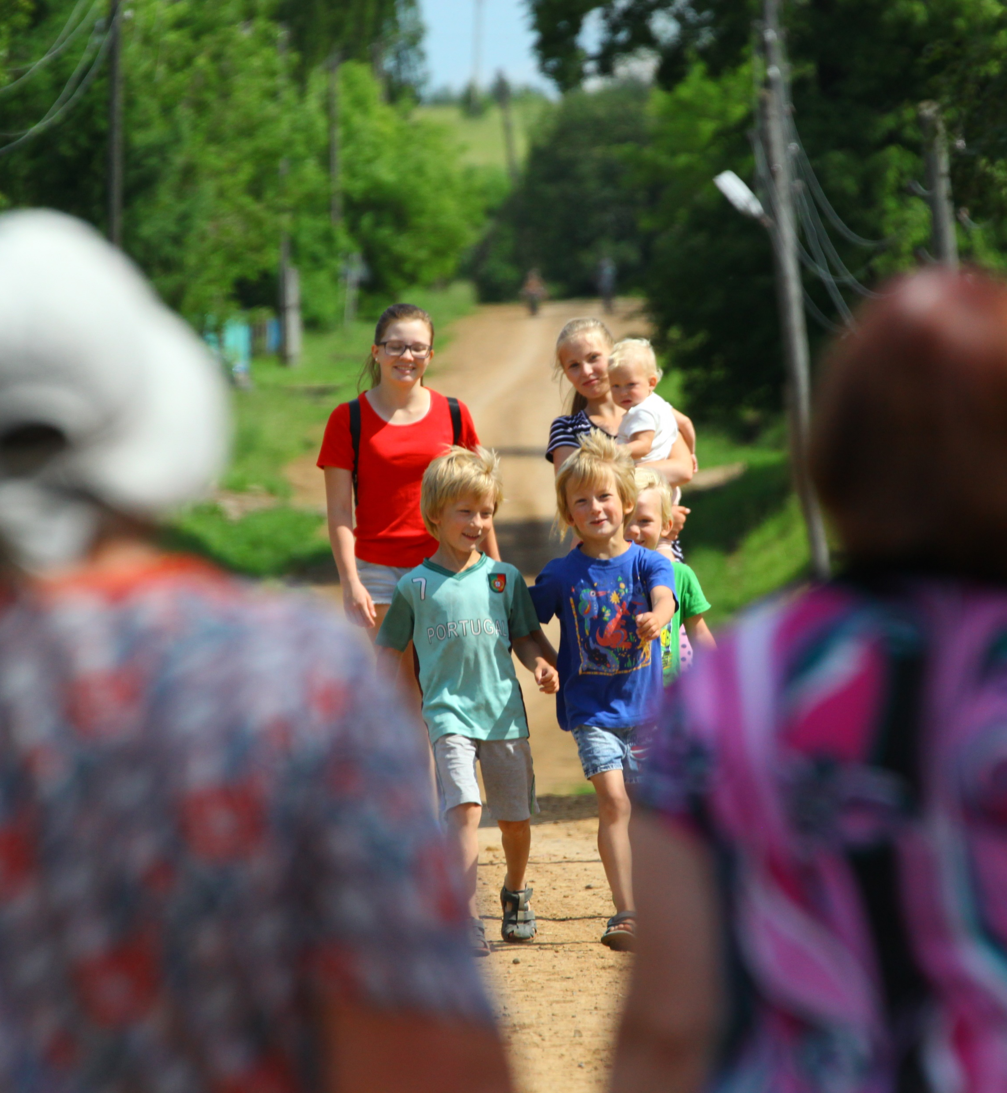
Expression of emotionality in Beserman Udmurt: babytalk, obscene words, and ideophones
Maria Usacheva, the Institute of Linguistics, RAS
mashastroeva@gmail.com
The work was supported by RFBR grant 16-24-17003 «The integral analysis of NPs in Finno-Ugric languages: support of reference and encoding of information structure»

Slide 2
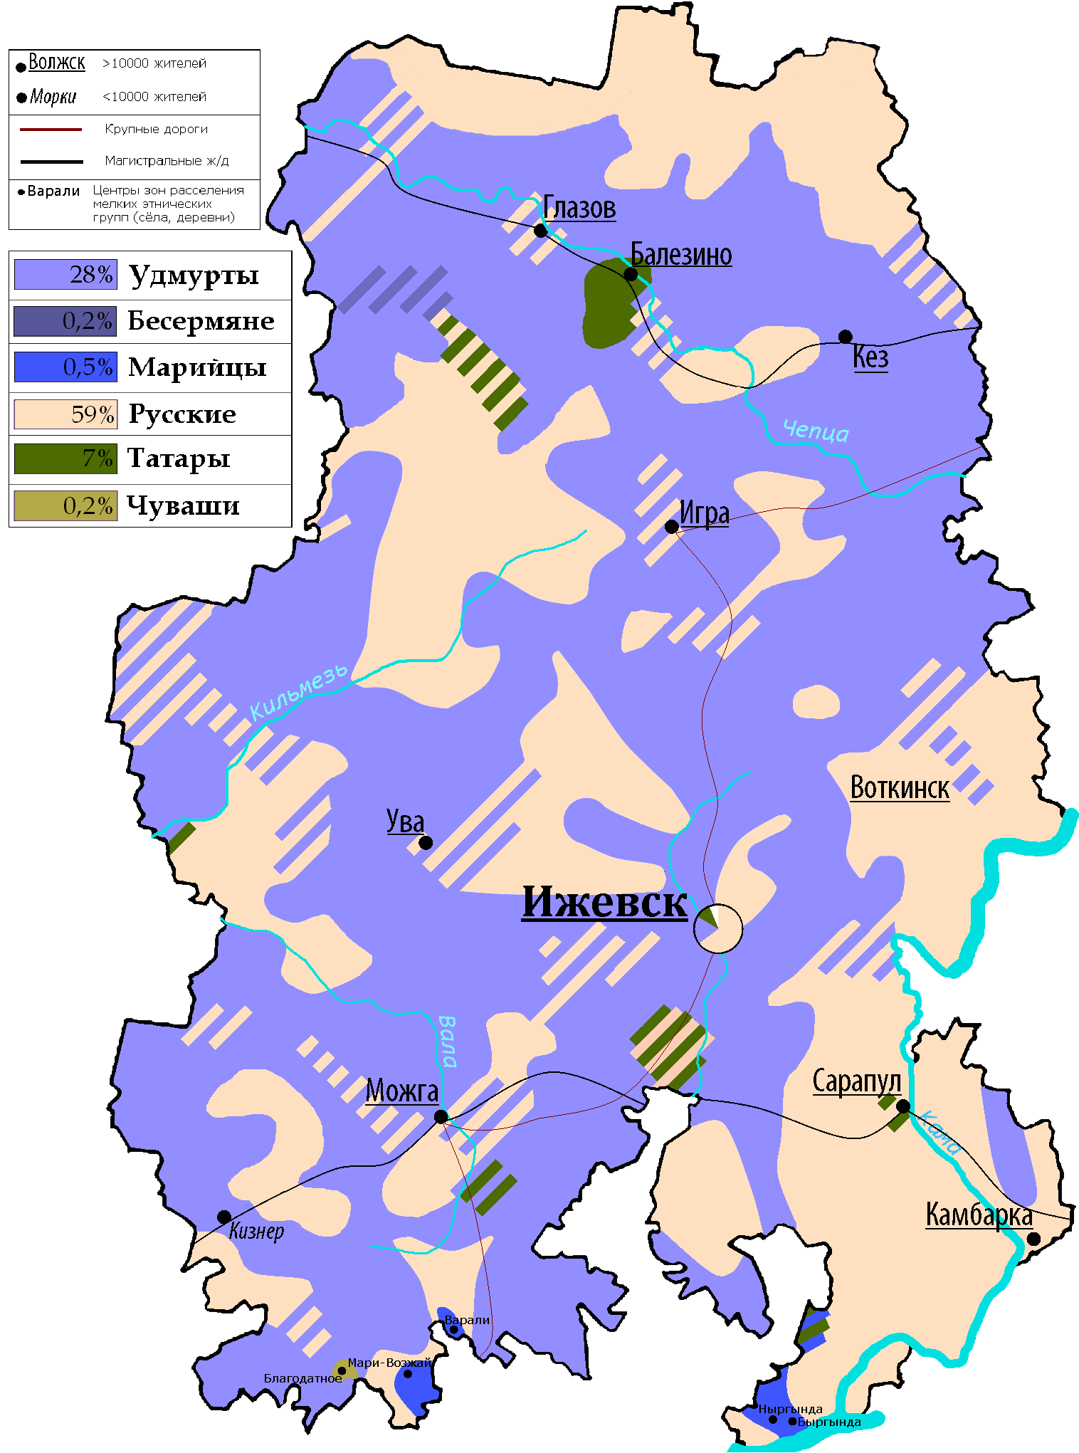
Besermans

Slide 3
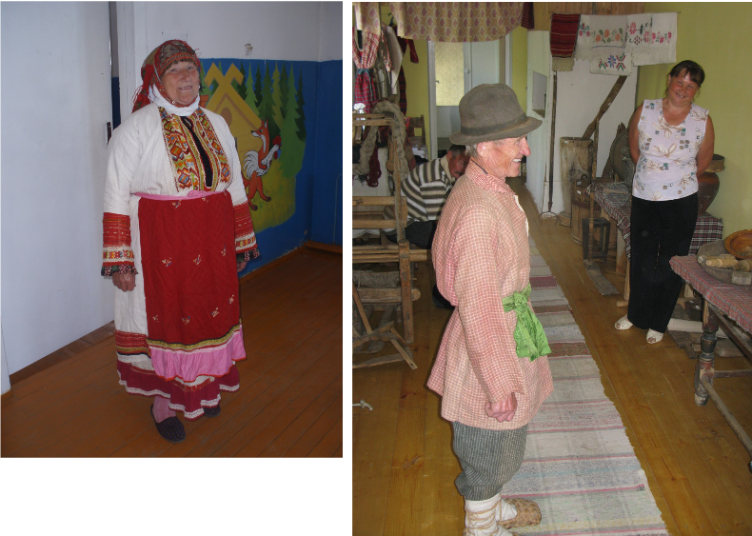
Besermans of Shamardan in traditional clothes

Slide 4

Emotionality
[Magomedova 2018]: babytalk and obscene words have a common emotional component which can be expressed by a common language means (Slavic languages – palatalization)
Beserman Udmurt (as other idioms of the Volga-Kama region) has ideophones
Ideophones are defined as “a vivid representation of an idea in sound” [Doke 1935: 118]
Ideophones (at least in Beserman Udmurt; see also [Alpher 2001] on ideophones in languages of southwestern Cape York Peninsula, Australia) are often pronounced with emotionality or stress
So, we assume that for ideophones expressing emotion is an important function.
Question 1: Maybe all the words with the important function of expressing emotionality have something in common?

Slide 5
Babytalk and ideophones
Babytalk is very close to ideophones and even can be treated as a special group of sound iconic words [Ivanov 2017: 88].
Common structural traits of ideophones and child directed words:
reduplication: pə̑tə̑r-pə̑tə̑r ʼto have a totally cracked surfaceʼ, bə̑čʼə̑k-bačʼə̑k ʼto pry hiding and appearing all the timeʼ; nʼunʼunʼ ʼwarmʼ, papi/papu ʼdressʼ, peper ʼbeautifulʼ;
units end with the same frequent element:
-ə̑r for ideophones: ačʼə̑r-wačʼə̑r, bə̑gə̑r-bə̑gə̑r, bulʼtə̑r etc. (95 of 315 ideophones in the dictionary);
-k for child-directed words: gagak ʼgooseʼ, muk ʼcowʼ, papak ʼcapʼ, tupik ʼbonnetʼ etc. (10 of 68).

Slide 6
Babytalk and ideophones
Child directed verbs are often derived from ideophones (it is also characteristic for ideophones): tʼišʼə̑nə̑ ʼto pissʼ (← tʼišʼ-tʼišʼ), tʼopə̑nə̑ ʼto fell downʼ (← tʼop-tʼop), manʼə̑nə̑ ʼto cut oneselfʼ (← manʼi-manʼi) etc.
But there are child-directed ideophones (bilʼ-bilʼ ʼto washʼ, tʼap-tʼap ʼto take a steam bath with a besomʼ) and other child-directed words (nouns, verbs, adjectives).
Child-directed words also have own traits like simplified morphological structure and palatalization (only at the word level, cf. Russian):
Mama l’ekoz, n’on’on’ šʼot’oz instead of more standard Anajed lə̑ktoz, nonok šʼot’oz ‘Your mother will come and feed you (lit. will give you teat)’

Slide 7
Babytalk and ideophones
In Beserman there are ideophones which can be addressed both to little children and to adults:
(1) Beserman Udmurt (fieldnotes):
Mon ə̑ž tʼaka-m-e ask-ə̑ gurt-e=ke e-z=na pə̑rə̑
I.nom sheep male-1-acc(sg) tomorrow-ill home-ill=if neg.prs-3sg=yet enter
manʼi-manʼi kar-o=nʼi!
cut make-fut.1sg=already
‘If my sheep does not come home (on time) tomorrow, I will slaughter it!’
(2) Beserman Udmurt (fieldnotes):
Purt-en e-n šə̑d, kiki-d-e manʼi-manʼi kar-o-d!
knife-instr neg.prs-2sg play hand.cd-2-acc(sg) cut make-fut-2(sg)
‘Don’t play with a knife, you’ll cut your hand!’

Slide 8
Babytalk and obscene words
In Beserman there are also words which can be child directed and obscene at the same time:
babə̑nə̑ ‘to sleep’:
(3) Beserman Udmurt (fieldnotes):
Bab=nʼi, mon=no bab-išʼko!
sleep.cd=already I.nom=add sleep.cd-prs.1sg
ʼ(to a beloved child) Sleep, I am also already sleeping!ʼ
(4) Beserman Udmurt (fieldnotes):
Mužik-e kə̑ǯʼa-mə̑n-ə̑z bab-e=nʼi.
husband-p.1 drink-res-p.3(sg) sleep-prs.3sg=already
ʼ(rude) Being drunk, my husband is already sleeping (~нализался и дрыхнет).ʼ

Slide 9
Ideophones and evaluative morphology
Question 2. Are there any correlations between hierarchies of ideophones and of evaluative morphology units?
EM is “an areal phenomenon” [Körtvélyessy 2015: 72] (as V. Ivanov has shown for ideophones of the Volga-Kama region)
Languages of the Volga-Kama region (incl. Beserman Udmurt) are those “with a rich imitative system”: they have all types of ideophones from the following hierarchy ([Ivanov 2018]; the hierarchy was offered in [Dingemanse 2012]):
sound < movement < visual patterns < other sensory perceptions < inner feelings and cognitive states
diminutives<augmentatives; honorifics<pejoratives [Körtvélyessy 2015: 71]

Slide 10
Diminutives
But (at least several) languages of the Volga-Kama region have poor evaluative morphology
“The evaluative morphology of Tatar is rather sketchy, evaluative suffixes being not very productive and the distribution of them among word classes is far from regular” (and the same is true for other Turkic languages) [Güney 2015: 310].
The situation in Beserman Udmurt is similar to those in Turkic languages. There are only several words with an element -ok which has diminutive or tender meaning: nə̑l-ok girl-DIM ‘a little girl’, pij-ok boy-DIM ‘my dear boy/man’, kət-ok belly-DIM ʼbelly (CD)ʼ; ?totok ʼshoesʼ, ?gužok ʼgladeʼ (cf. Standard Udmurt guždor ʼglade).
In Komi diminutives are borrowed from Russian (nyv-ka ʼa girlʼ). Yazva Komi has diminutive suffix – pjan, and there are no ideophones attested (but the dictionary is not very big)

Slide 11
Question 3
A question offered in [Ivanov 2018]: How it has happened that Finno-Ugric languages of the Volga-Kama region have borrowed Turkic system of ideophones and not vice versa?
While speaking Russian Beserman people use either Beserman child-directed words (Что-то не нравится, gə̑də̑?) or their calques («Ах ты, маленькая каканька!» cf. Bes. tʼitʼašʼ ʼaddress to a little child; lit. crap-ptcp.actʼ) and do not use Russian features of babytalk like integral palatalization. There are CD-words borrowed from Russian: mama, papa, tprukonʼ ʼcowʼ (there is a word «тпруконя вят. корова» in Dahlʼs dictionary), buk ʼthe sound of falling downʼ - but not many.
Children learn things connected to emotionality (obscene words; ideophones) very fast.

Slide 12
Question 3
[Kosareva 2018]: The Beserman variety of Udmurt presumably arised as a result of a vast majority of families with an Udmurt-speaking father and a Turkic-speaking wife.
A hypothesis based on personal observations: Maybe children often had Turkic-speaking caregivers?

Slide 13
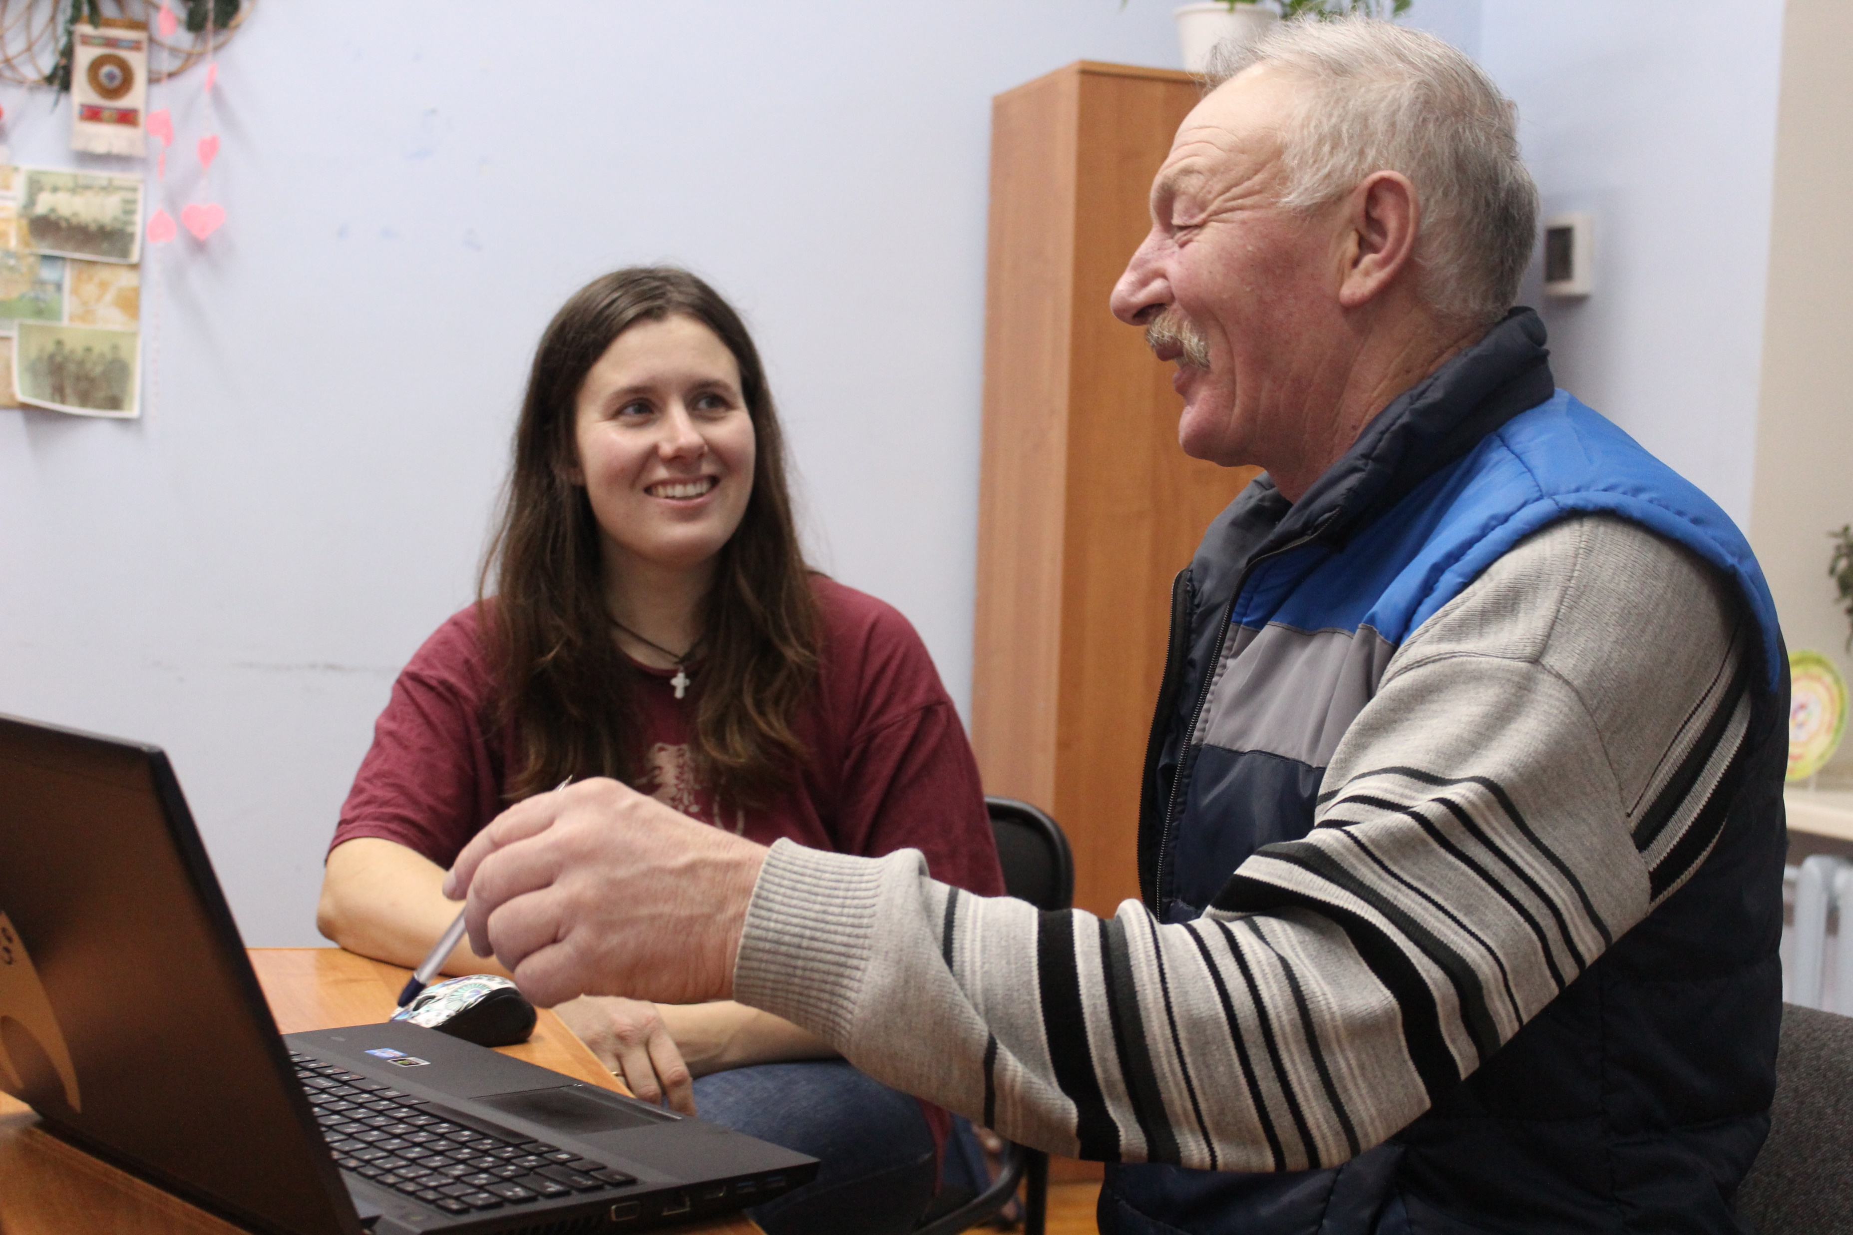
Thank you for your attention!

Slide 14
References
Alpher, Barry. 2001. Ideophones in interaction with intonation and the expression of new information in some indigenous languages of Australia. In F. K. Erhard Voeltz, Christa Kilian-Hatz (eds.) Ideophones. Typological studies in language 44. Amsterdam/Philadelphia: John Benjamins. Pp. 9 – 24.
Dingemanse, Mark. 2012. Advances in the cross-linguistic study of ideophones. In Language and Linguistics Compass, vol. 6. Pp. 654-672.
Doke, Clement M. 1935. Bantu linguistic terminology. London; New York Longmans, Green.
Güney, Fatma Şahan. 2015. Tatar. In Grandi, Nicola, and Körtvélyessy, Lívia (eds.). Edinburgh Handbook of Evaluative Morphology. Edinburgh: Edinburgh University Press. Pp. 310 – 320.
Ivanov, Vladimir A. 2017. Upotrebleniye izobrazitelnykh slov v znachenii i funkcii intensifikatora (na material yazyka besermian) [Sound iconic words as intensifiers (by the material of Beserman Udmurt)]. In: Yazykovyje kontakty narodov Povolzhya X: aktualnyje problem normativnoj I istoricheskoy fonetiki, grammatiki, leksikologii i stilistiki. Izhevsk: Izdatelskiy centr “Udmurtskij universitet”. 81–90.
Ivanov, Vladimir A. 2018. Ideophones in the Volga-Kama languages. Report at 4th workshop on the languges of Volga-Kama Sprachbund. Moscow, 18th November 2018.

Slide 15
References
Kosareva, Irina A. 2018. Udmurtsko-tyurkskoye vzaimodeystviye v svete besermianskoy problematiki [Interaction between Udmurts and Turkic people in Beserman perspective]. Report at the conference “Language, history, and culture of Besermans: the current state and perspectives of studies” Glazov,20th April 2018.
Körtvélyessy, Lívia. 2015. Evaluative Morphology and Language Universals. In Grandi, Nicola, and Körtvélyessy, Lívia (eds.). Edinburgh Handbook of Evaluative Morphology. Edinburgh: Edinburgh University Press. PP. 61-73.
Magomedova, Varvara. 2018. What do babytalk and obscene words have in common? Report at Word Formation Theories III. Koshice, Slovakia, 30th June 2018.

