Slide 1



Emergence of relative clauses in Russian Sign Language
Khristoforova Evgeniia
University of Amsterdam
Russian State University for the Humanities
Project #17-18-01184

Slide 2
Outline
Relative clauses: definition and typology
Emergence of relative clauses in old spoken and young spoken (creole) languages
Relative clauses in Russian Sign Language: relevant properties (Khristoforova & Kimmelman 2020)
Grammaticalization of relative clauses in RSL
Tentative summery: on the way but not there yet.
Future research: plans for grammaticality judgments

Slide 3
Relative clauses: definition, typology and development
(Hopper &Traugott 1984)
(de Vries 2002)
(Lehmann 2008)

Slide 4
Relative clauses
A relative clause (RC) is a dependent clause.
RC is connected to the matrix clause (MC) by a syntactically and semantically shared pivot – the head of RC.
(Branchini 2014: 58)
[I am reading a book_{Obj}, [which you gave me __ _{Obj} ]_{RC}]_{MC}
[The book_{Subj}, [which you gave me __ _{Obj} ] is fascinating _{RC}]_{MC}
(English)

Slide 5
RC in spoken languages: EHRC and IHRC
Externally-headed RC (EHRC):
I like the girl, [which ___ is reading a book] _{RC} (English)
Internally-headed (IHRC):
Tye [ye ne ye so min ye]_{RC} san.
man pst I pst horse rel see buy
“The man bought the horse that I saw”
(Bambara (Mande language family, Mali))
(Keenan 1985)
[1]
[2]

Slide 6
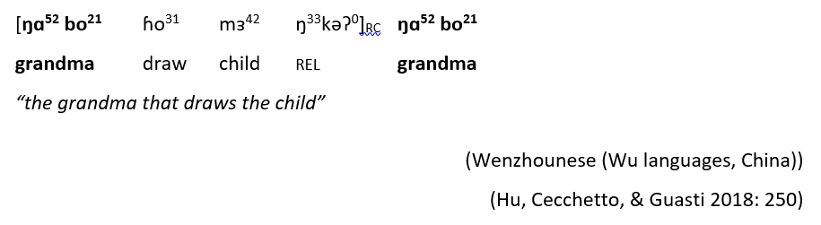
RC in spoken language
Double-headed RC (DHRC):
[ ŋɜŋ
Free/headless RC:
[What Peter carries __]_{RC} is mine.
(English)
[3]
[4]

Slide 7
RC in spoken languages: correlatives
[5]
a. [jo ___ khaRii hai] [vo laRkii lambii hai].
REL standing is DEM girl tall is
b. [jo laRkii khaRii hai] [vo ____ lambii hai].
REL girl standing is DEM tall is
c. [jo laRkii khaRii hai] [vo laRkii lambii hai].
REL girl standing is DEM girl tall is
Lit.”Which girl standing is that tall is.”
“The girl who is standing is tall”
EHRC , IHRC and DHRC:
[ …. [ head [ RC]]_{NP} …]
Correlatives:
[ … {head}...]_{CPrel} […{head}…]_{MC}
(Hindi)
(Dayal 1991)

Slide 8
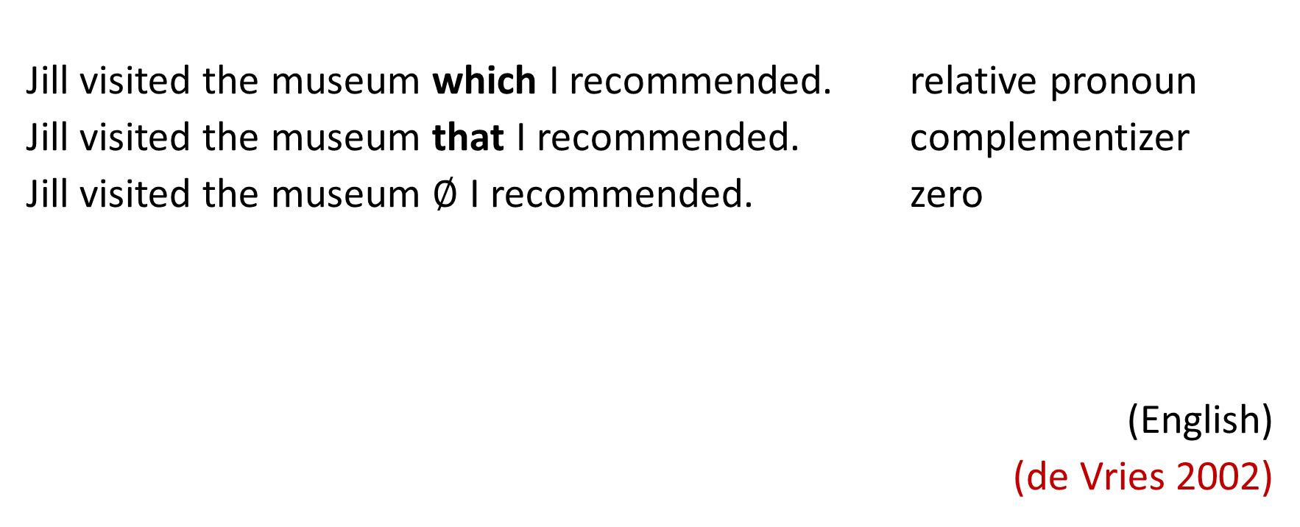
Relative elements
Jill visited the museum which I recommended. relative pronoun
Jill visited the museum that I recommended. complementizer
Jill visited the museum $∅$ I recommended. zero
(English)
(de Vries 2002)

Slide 9
RC in spoken languages:
Relative clause across spoken language vary in terms of relativization strategies.
All this strategies can be derived by one underlying syntactic mechanism (e.g. head-raising analysis (Donati & Cecchetto 2011)).
All spoken languages investigated so far employ one of the strategies (or even more than one). (Lehmann 1984)
But how this diversity/uniformity came about?

Slide 10
Emergence of RC: old spoken languages
the grammaticalization of information structures involving anaphoric relations in adjacent clauses (Lehmann 1988, 2008)
the development of relative markers from demonstrative pronouns (Heine and Kuteva 2007, Ohori 2011)
gradual syntactic integration of RCs through paratactic, hypotactic and subordinate stages (Hopper and Traugott 1993).

Slide 11
Grammaticalization of anaphoric relations conditioned by information structure
[ ….. N_{i} ]_{S1} [ Pro_{i} …] _{S2}
You gave me a book. That {book} is amaizing
[ ….. N_{i}] ^{Topic}_{S1} [ Pro_{i} …]_{S2} => [[ ….. N_{i}]_{RC} Pro_{i} …]_{MC}
As for the book you gave me, that {book} is amaizing
[ ….N_{i}^{Focus}]_{S1} [Pro_{i} …]_{S2}^{Comment} => [ …. N_{i} [Pro_{i} … ]_{RC}]_{MC}
You gave me a book that ___is amaizing
whatever proposition is pressuposed , it gets subordinated
(Lehmann 2008)

Slide 12
Sources of relativizers:
Demonstratives ( English: that)
Wh-elements (English: which; French: que; Russian: kotorji)
Nominalizers (Classical Chinese: zhě and suǒ )
<…>
(Heine and Kuteva 2002)
(Ohori 2011)

Slide 13
Syntactic integration of RC
parataxis hypotaxis subordination
[-dependent] [+dependent] [+dependent]
[-embedded] [-embedded] [+embedded]
[…]S1 […]S1 [ N_{i} […]_{RC} Pro_{i}…]_{S} [[… N […]_{RC}…]_{S}
(Hopper & Traugott 1993)
I just saw a guy. He reminds me of Sam
The guy I just saw, he reminds me of Sam
The guy (that) we just saw reminds me of Sam

Slide 14
Relative constructions in Sranan
Sranan – English-based creole language spoken in Suriname; emerged in the 17th century.
(Bruyn 1995)

Slide 15

Grammaticalization of RC: evidences from Sranan (Bruyn 1995)
the grammaticalization of anaphoric relations
demonstratives pronoun => relative maker
parataxis => hypotaxis => embedding

Slide 16


Grammaticalization of RC: evidences from Sranan
the grammaticalization of anaphoric relations
demonstratives pronoun => relative maker
dissi (dem) => di(si) (rel)
[6]
mi za pay joe retti likki joe man [dissi dedde]
1sg fut pay 2sg right like 2sg man rel/dem dead
‘I will pay (punish) you just as I did your man (husband), who died”
‘I will pay (punish) you just as I did your man (husband); he (this one) died”
(Early Sranan)
(Bruyn 1995)

Slide 17
Grammaticalization of RC: evidences from Sranan
parataxis => hypotaxis
(Early Sranan)
[7]
en den zomma [disi broke da koffi na zabatim]
and def.rl people rel break def coffee at evening
den no moese myki zoo menni balibali lange da zinge
3pl neg must make so many shouting with def singing
“and the people that will peel coffee beans tonight they mustn’t make so much noise with their singing”
[ … N_{i} [RC ] Pro_{i} ...]_{MC}
(Modern Sranan)
hypotaxis => embedding
Dan den sma [di a afsiri ben seni kon] dray go na a oso baka
then def.pl person [rel def officer pst send come] turn go at def house back
‘Then the people whom the officer had sent there came back at the house’
[ … [RC] … ] _{MC}
[8]
(Bruyn 1995:210)

Slide 18
Can we observe a similar developmental process in sign languages (Russian Sign Language)?
Yes, but we have no diachronic record

Slide 19
Relative constructions in Russian Sign Language (RSL)
RSL – sign language used by a deaf community in Russia; emerged in 19th century; ~ 120 000 signers
(Khristoforova & Kimmelman 2020)

Slide 20
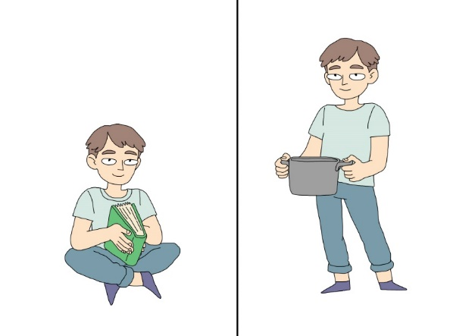
Data
Elicitation data
9 signers
8 pairs of pictures
88 relative clauses
+ Grammaticality judgments
4 signers
position and distribution of relative signs
Question:
“Which of the boys is sitting?”
Expected answer:
“The boy [who is reading a book] is sitting.”
(Khristoforova & Kimmelman 2020)

Slide 21
Relative clause in RSL: non-manual markers
Non-manual markers (NMMs) are linguistically relevant facial expressions and body and head movements bearing phonological, morphological, syntactic and discourse functions (Pfau and Quer 2010)
All SLs mark RCs with specialized NMMs (Dachkovsky 2020)
 | eye blink | head leans/turns | raised eye brows | squints
RC |  | 28 |  | 17
 | 77
MC |  | 34 | 28
But not RSL!
(Khristoforova & Kimmelman 2020)

Slide 22
Relative clauses in RSL: position of the head
[9] i like car blue [ __ turn.left left turn.left]_{Rc}
‘I like the blue car that is turning left.’
eb
[10] i like [ball girl sit hold]_{RC}
‘I like the girl that is holding a ball.’
[11] i more like car [which car turn.left]_{RC}
‘I prefer the car that is turning left.’
EHRC
IHRC
DHRC
(Kimmelman & Khristoforova 2020)

Slide 23
Relative clauses in RSL: relative elements
which invariant mouthing /kotorij/ | ix relative pronoun
which+ix relative pronoun mouthing /kotorij/
[ ___{RC-initial} …. ___{RC-final}]_{RC}
(Kimmelman & Khristoforova 2020)

Slide 24
Examples of relative signs in RSL
[12] index₁ like car blue [ turn.left left turn.left]_{Rc}
‘I like the blue car that is turning left.’
[13] yellow flower [which+ix girl draw]_{rc}
‘The flower that girl draws is yellow’
[14] boy [which wash dog ix] beautiful
‘The boy who is washing a dog is beautiful.’
[15] [girl cat pat which+ix] sit
The girl, which is patting the cat, is sitting.
zero
RC-initial
RC-initial; RC-final
RC-final
(Khristoforova & Kimmelman 2020)

Slide 25
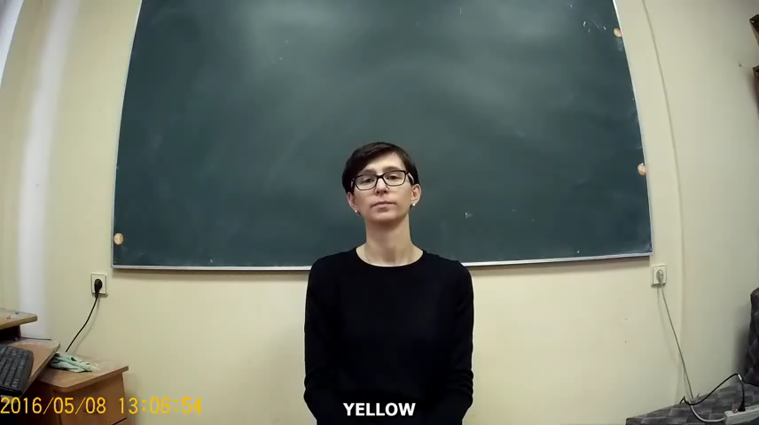
yellow flower which+ix girl draw
The flower that girl draws is yellow

Slide 26
Dislocated relative clauses
Extraposed RC: 20
[16] dog more beautiful [ix boy hug ix]_{rc} [[N _] V O ]_{MC}[RC]
‘The dog, which the boy hugs, is more beautiful’
Fronted RC: 7
[17] [girl draw]_{rc} i like index₃ flower [RC] [ S V _ ]
‘I like the flower, which the girl draws’
(Khristoforova & Kimmelman 2020)

Slide 27
Zero-marked RC: example
RSL is a pro-drop language
[18]
eb
[boy read book] [ sit.legs.crossed]
“The boy who is reading a book is sitting with his legs crossed”
“The boy is reading. {He} is sitting with his legs crossed”
Both paratactic and relative clause reading are equally possible (NMMs do not help).
Additional testing is needed
Question:
“Which of the boys is sitting?”

Slide 28
Distribution of relative elements in adjacent RC
If there is only one relative sign, it always marks the boundary between RC and MC!
[MC]rel[RC] 30 *rel[RC][MC]
[RC]rel[MC] 7 *rel[MC][RC]
*[RC][MC]rel
*[MC][RC]rel
Grammaticality judgments :
[RC]rel[MC]
[MC]rel[RC]
?rel[RC][MC]
*[MC][RC]rel
more acceptable
[ ….. N_{i}]_{S1} [ Pro_{i}…]_{S2} => [[ ….. N_{i}]_{RC} Pro_{i} …]_{MC}
=> [ …. N_{i} [Pro_{i} … ]_{RC} ]_{MC}
(Lehmann 2008)
less acceptable

Slide 29
[girl read which] i like * i like [girl read which]
TopP
TP
DP _{rel}
<…>
I
<…>
VP
[girl read which]
TP
like
<…>
DP _{rel}
I
VP
*[girl read which]
like
[which girl read]
DP _{rel}

Slide 30
(Non-)embedded RC modifying MC-subject
RC adjacent to MC: 66/88 (75%)
[S V O [RC]] 12 ambiguos with adject [MC][RC]
[S [RC] V O]: 10
eb
[19] boy which dog wash ix beautiful
“The boy, which is washing a dog, (that one) is beautiful”
all have copy pronoun
No embedded RCs without copy pronoun!
But where is the clause boundary? – hard to tell

Slide 31
Grammaticalization of RC: evidences from RSL
grammaticalization of anaphoric relations
in progress as evidenced by distribution of relative-elements
demonstratives pronoun => relative maker
relative use of IX
parataxis => hypotaxis => embedding
parataxis in zero-marked relatives
hypotaxis in overtly-marked RC (evidenced by copy pronoun)

Slide 32
Tentative conclusions
Grammaticalization of RCs in RSL is still ongoing.
As in other spoken and signed languages (Israeli SL, Dachkovsky 2018,2020)), this process is realized via complex interplay between the grammaticalization of anaphoric relations in discourse patterns, grammaticalization of relative markers from demonstratives and gradual syntactic integration of RCs.

Slide 33
Future testing
Are zero-marked relatives actually paratactic?
Quantifier scope:
_________________rc zero-marked RC
_______np parataxis
[ all boy read book] [ sit.legs.crossed]

Slide 34
Future testing
Are overtly-marked relatives actually hypotactic?
Than, resumptive pronoun can be separated from the RC by
Topic (time adverbial)
boy which dog wash yesterday ix cat wash
The boy, which is washing a dog; yesterday, he washed a cat.
b) finite clause
boy which dog wash I think that ix beautiful
The boy, which is washing a dog; I think he is handsome.

Slide 35
References
Branchini, C. 2014. On Relativization and Clefting: An Analysis of Italian Sign Language. Sign Languages and Deaf Communities [SLDC], v. 5. Boston: De Gruyter Mouton ; Ishara Press.
Bruyn, Adrienne. ‘Grammaticalization in Creoles : The Development of Determiners and Relative Clauses in Sranan’. IFOTT, 1995.
Dachkovsky, S. 2018. Grammaticalization of Intonation in Israeli Sign Language: From Information Structure to Relative Clause Relations. PhD Dissertation, University of Haifa.
Heine, Bernd, and Tania Kuteva. The Genesis of Grammar: A Reconstruction. Studies in the Evolution of Language 9. Oxford ; New York: Oxford University Press, 2007.
Hopper, Paul J., and Elizabeth Closs Traugott. Grammaticalization. 2nd ed. Cambridge Textbooks in Linguistics. Cambridge, UK ; New York, NY: Cambridge University Press, 2003.
Keenan, E.L. 1985. Relative Clauses. In Language Typology and Syntactic Description, edited by T. Shopen, 2:141–70. Cambridge University Press.
Kimmelman, Vadim, and Evgeniia Khristoforova. ‘Relativization in Russian Sign Language: Basic Features’, 2019.

Slide 36
References
Lehmann, Christian. ‘Information Structure and Grammaticalization’. In Typological Studies in Language, edited by Elena Seoane and María José López-Couso, Vol. 77. Amsterdam: John Benjamins Publishing Company, 2008.
Lehmann, Christian. ‘On the Typology of Relative Clauses’. Linguistics 24, no. 4 (1986). https://doi.org/10.1515/ling.1986.24.4.663
Ohori, Toshio. ‘The Grammaticalization of Subordination’. In The Oxford Handbook of Grammaticalization, edited by Bernd Heine and Heiko Narrog, 1–23. New York: Oxford University Press, 2011.
Pfau, R., & Quer, J. (2010). Nonmanuals: Their prosodic and grammatical roles. In D. Brentari (Ed.), Sign languages (pp. 381–402). Cambridge: Cambridge University Press
Vries, M. de. 2002. The Syntax of Relativization. LOT Dissertation Series 53. Utrecht: LOT.

